Slide 1



Full-body Human De-lighting with Semi-Supervised Learning
ACCV 2024 - ORAL PRESENTATION
Josh Weir, Junhong Zhao, Andrew Chalmers, Taehyun Rhee

Slide 2
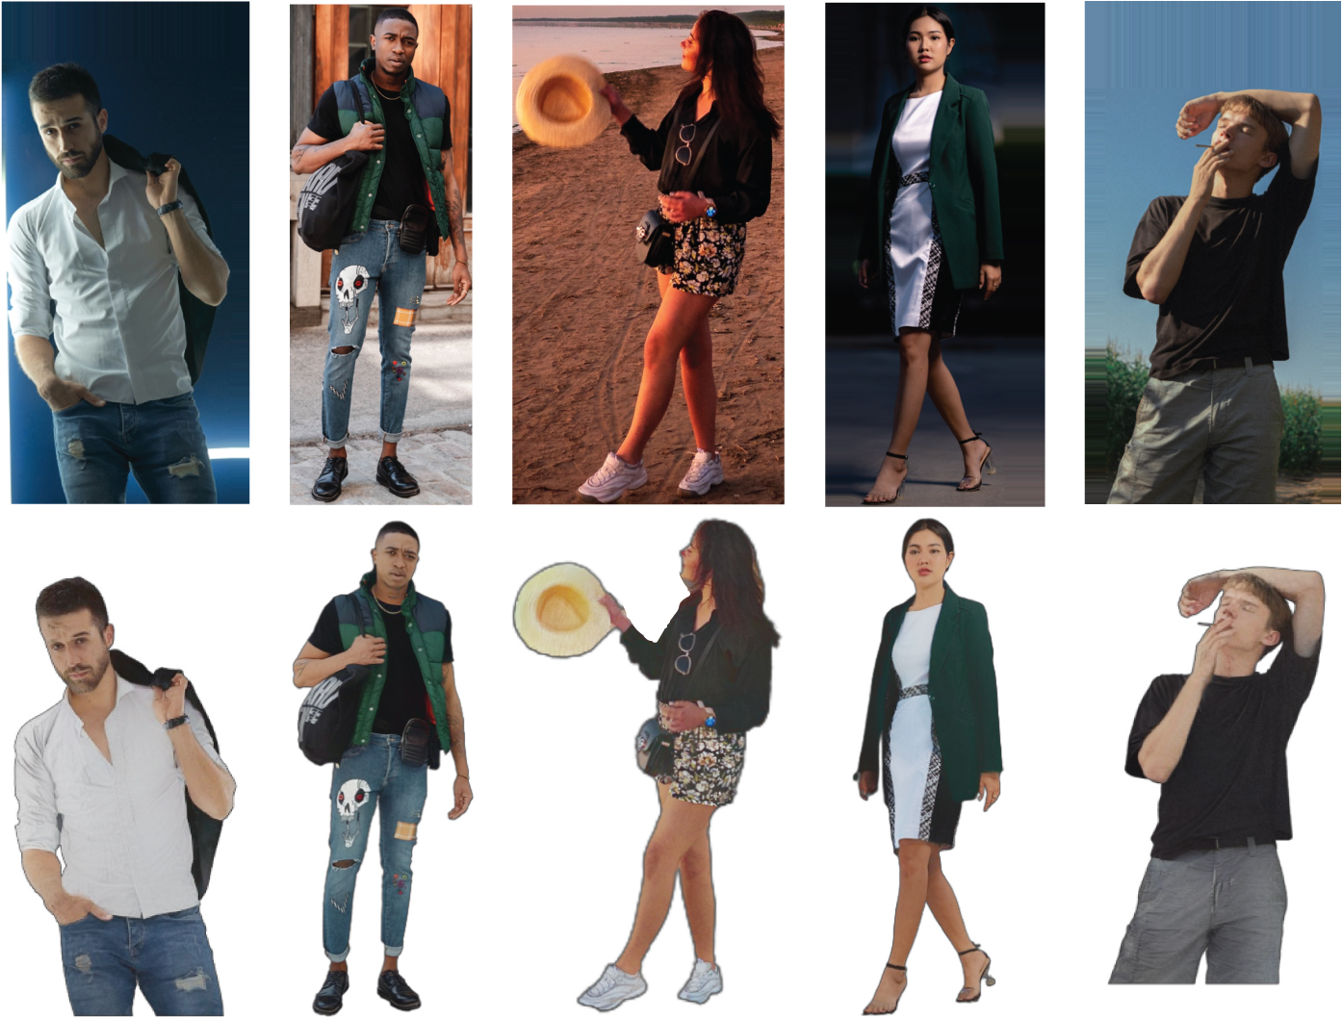
Motivation
De-lighting removes light artifacts from images, recovering albedo
Benefits downstream applications
Input
Output

Slide 3
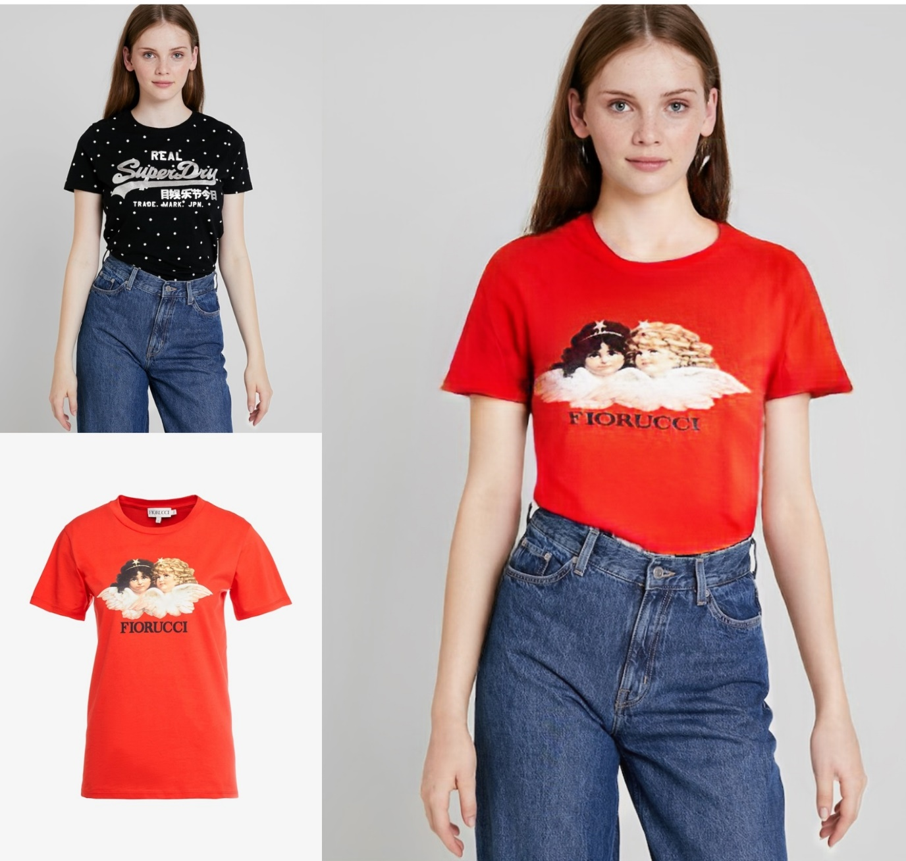
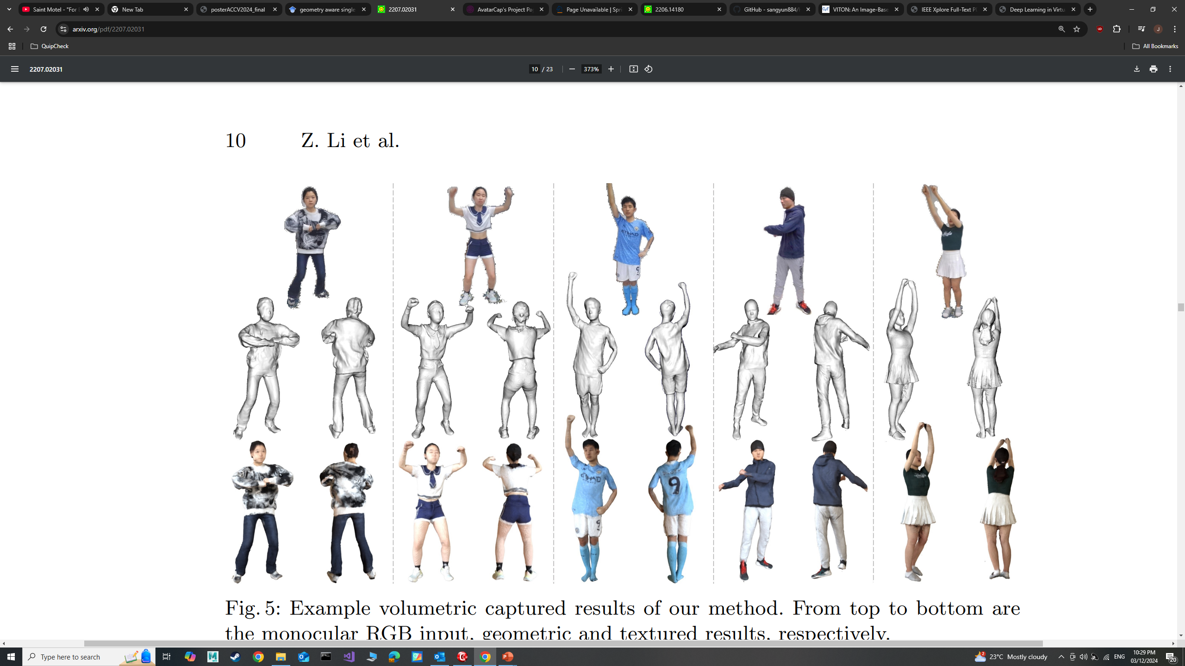
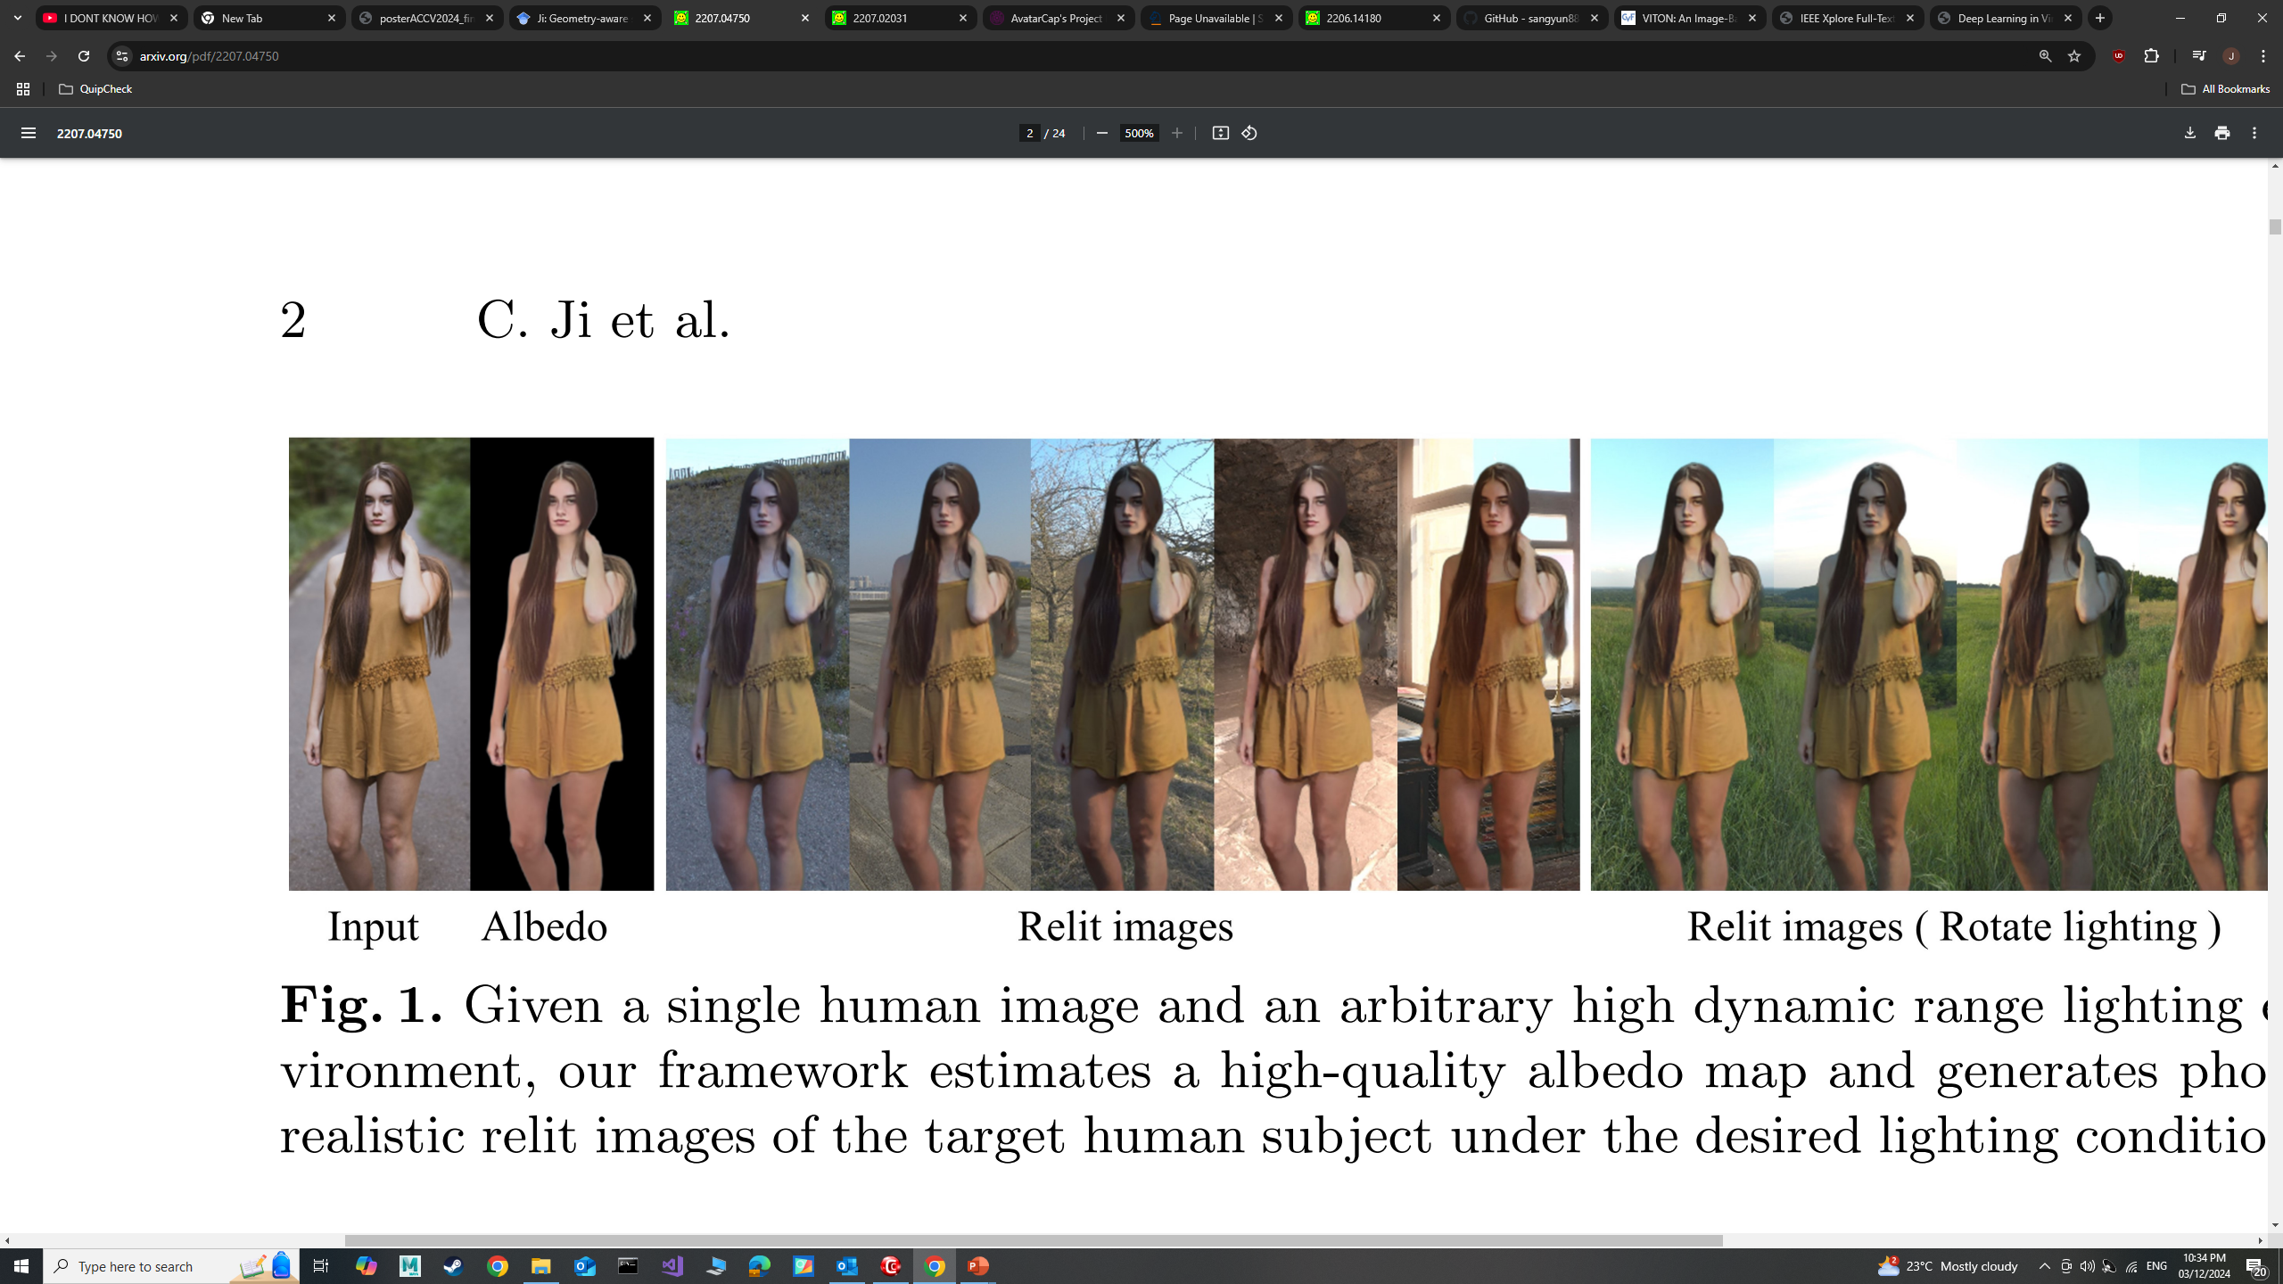
Motivation
De-lighting removes light artifacts from images, recovering albedo
Benefits downstream applications
Virtual Try-on
Lee et al, “High resolution virtual try-on with misalignment and occlusion handled conditions”, ECCV, 2022
Input
Avatar Generation
Output
Li et al, “AvatarCap: Animatable Avatar Conditioned Monocular Human Volumetric Capture”, ECCV, 2022
Relighting
Ji et al, “Geometry-aware single-image full-body human relighting”, ECCV, 2022

Slide 4
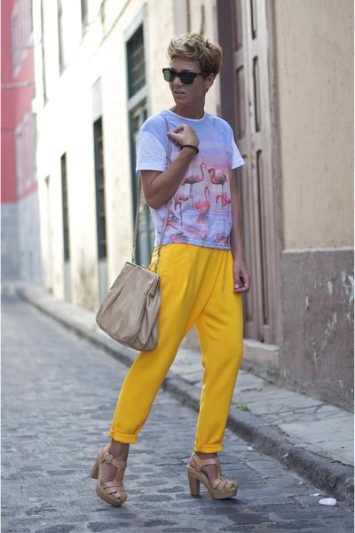
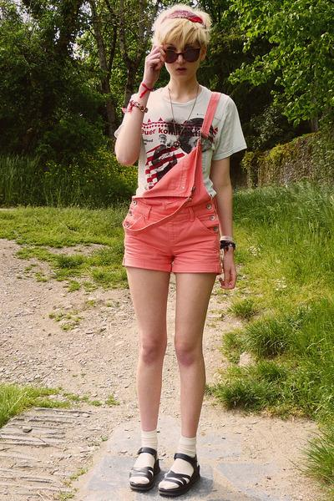


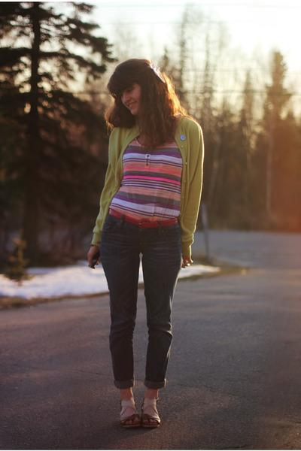


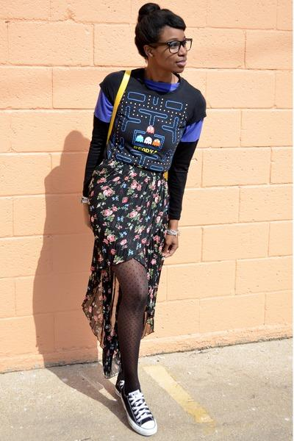
Challenges
Full-body images feature:
A wide range of textures and materials.
Intricate shadows created by varying body poses and shapes
Deep learning solutions requires large and diverse datasets
Creating labelled datasets for human de-lighting is expensive

Slide 5
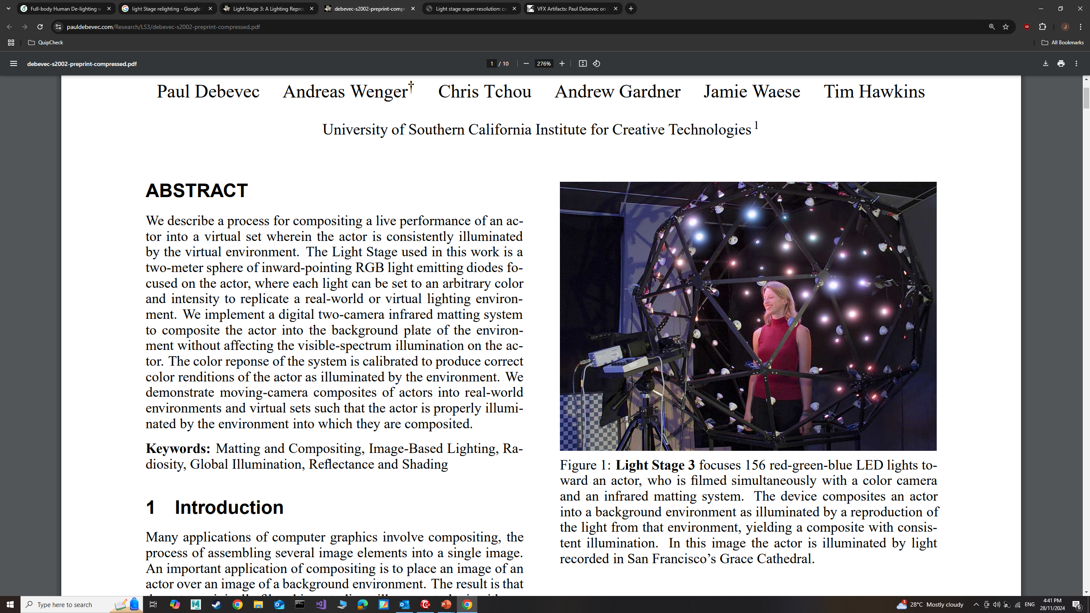
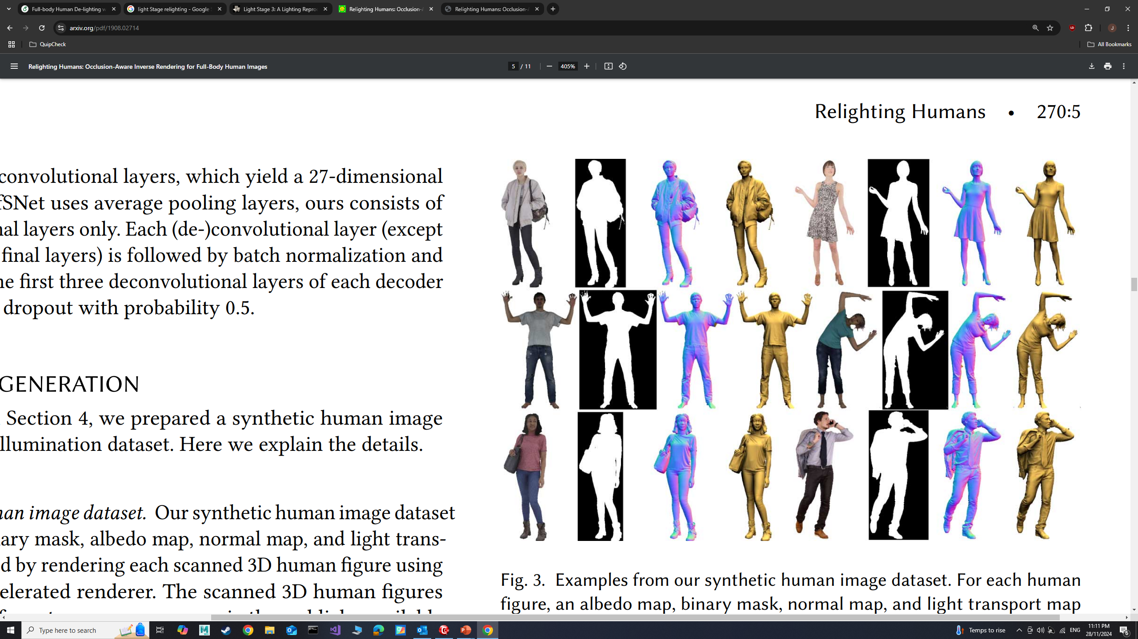
Challenges – Training Data Acquisition
Light Stage
Ground-truth labels
High-quality images
Expensive acquisition
Synthetic 3D Models
Ground-truth labels
Quality varies
Expensive acquisition
Real-world Images
No ground-truth labels
High quality images
Inexpensive
Debevec et al, “A Lighting Reproduction Approach to Live-Action Compositing”, ACM Trans. Graph., 2002
Kanamori et al, “Relighting Humans: Occlusion-Aware Inverse Rendering for Full-Body Human Images”, ACM Trans. Graph., 2018

Slide 6
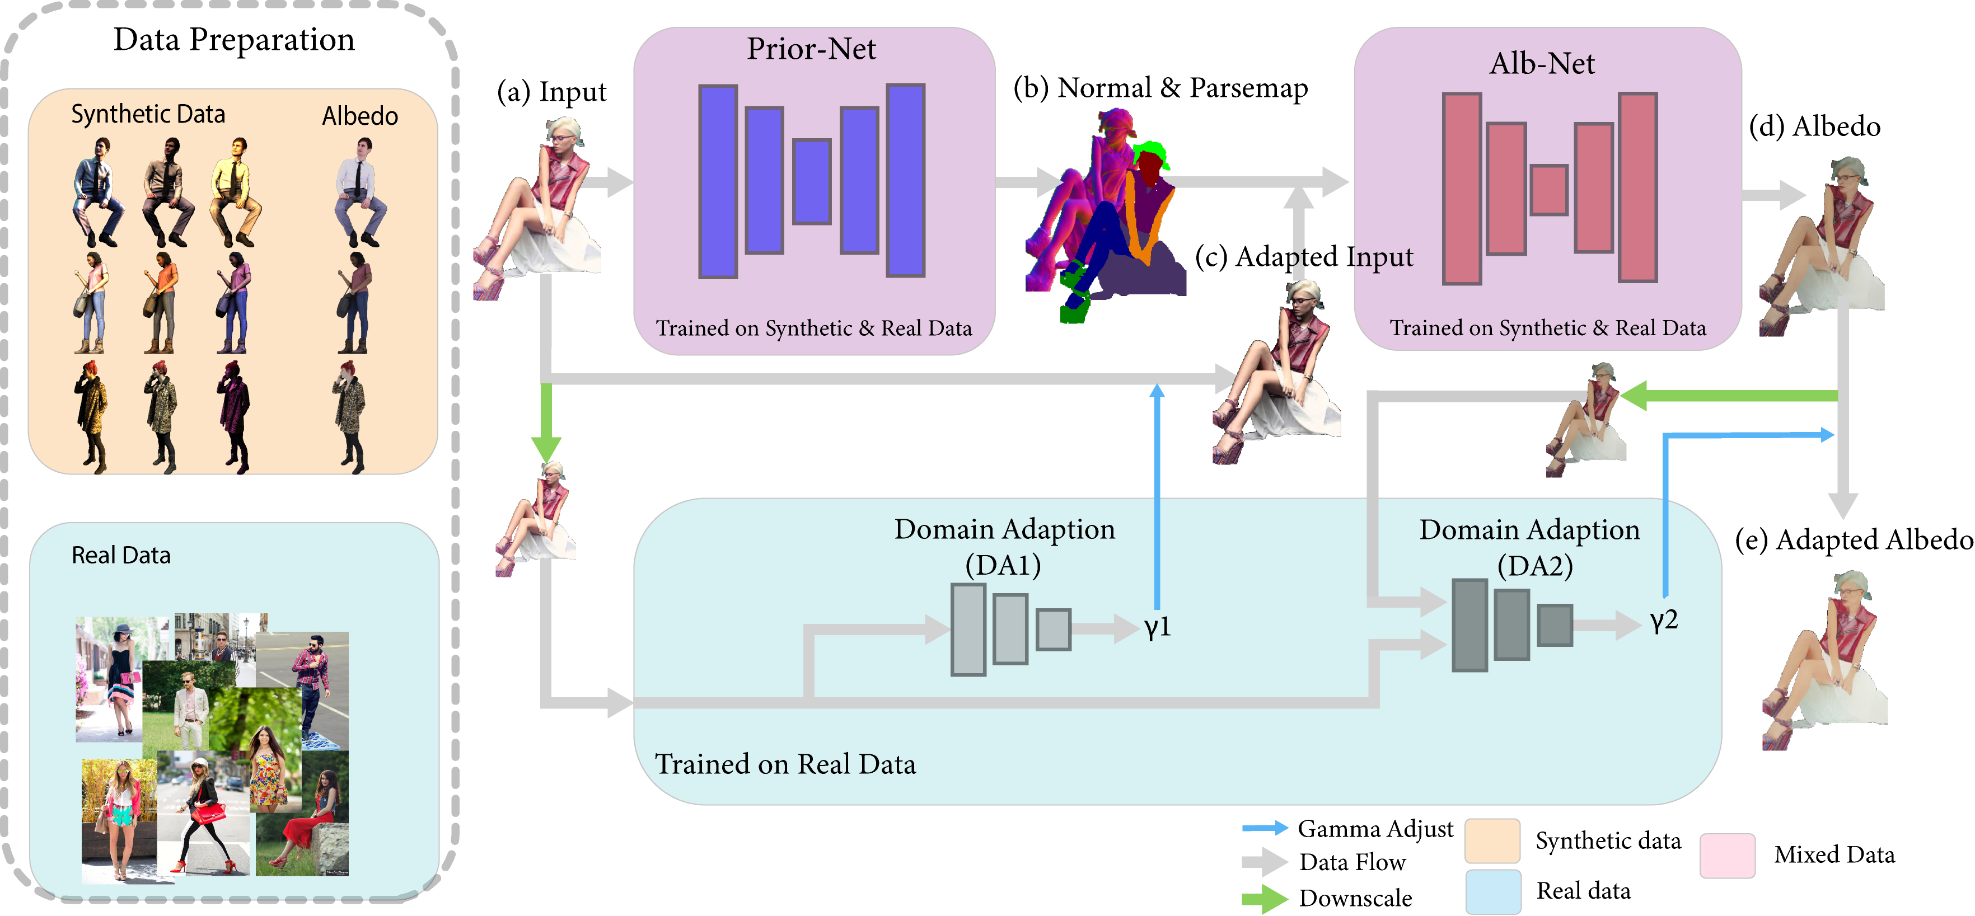
Pipeline
Albedo Loss
Global Sparsity Loss
DA Loss

Slide 7
Pipeline
Albedo Loss
134 3D models
Albedo + Normal + Parsemap labels
Lambertian reflectance
Global Sparsity Loss
17,706 photographs
Parsemap labels only
Realistic reflectance
DA Loss

Slide 8
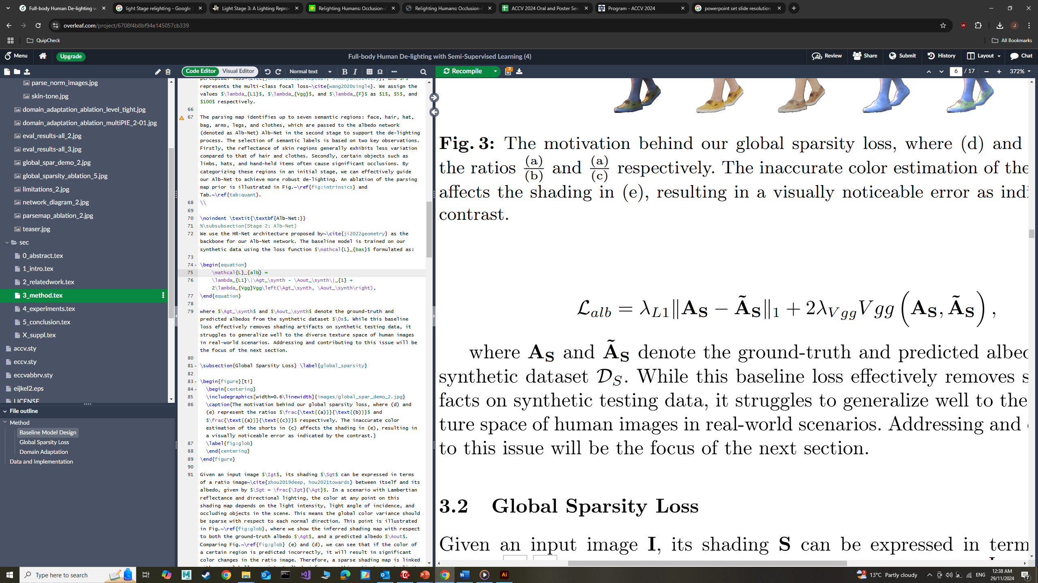
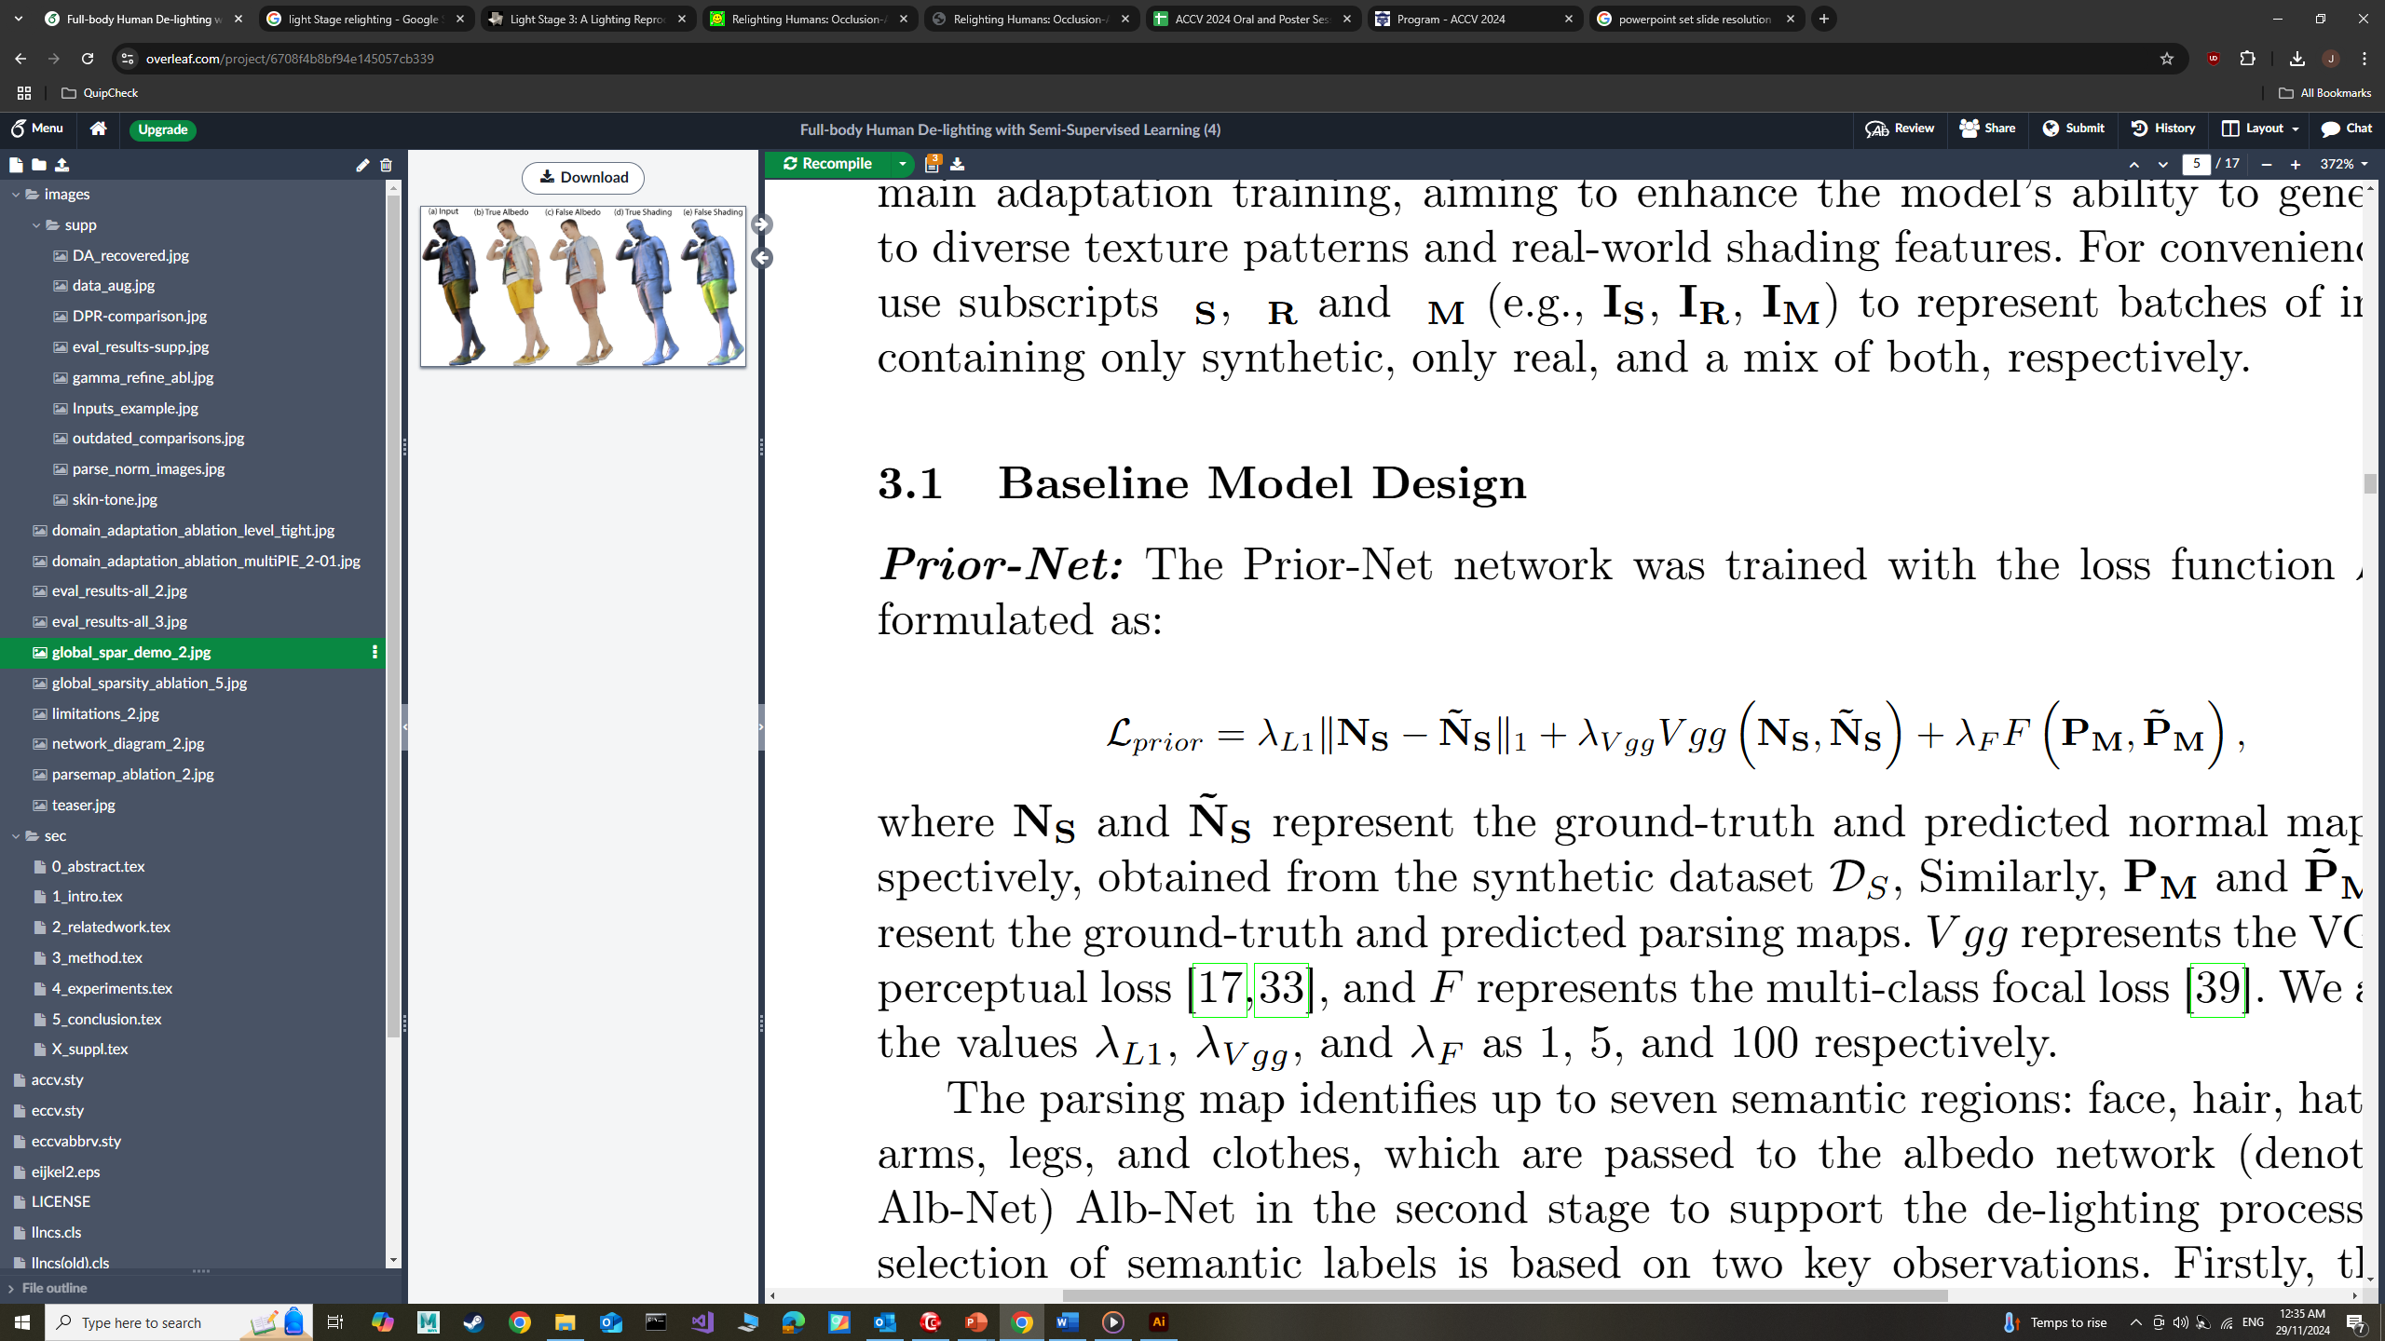
Pipeline
Albedo Loss
134 3D models
Albedo + Normal + Parsemap labels
Lambertian reflectance
Global Sparsity Loss
Prior Loss
Albedo Loss
Prior Loss
17,706 photographs
Parsemap labels only
Realistic reflectance
DA Loss

Slide 9
Pipeline
Albedo Loss
134 3D models
Albedo + Normal + Parsemap labels
Lambertian reflectance
Global Sparsity Loss
Global Sparsity Loss
Prior Loss
Albedo Loss
Prior Loss
17,706 photographs
Parsemap labels only
Realistic reflectance
DA Loss

Slide 10
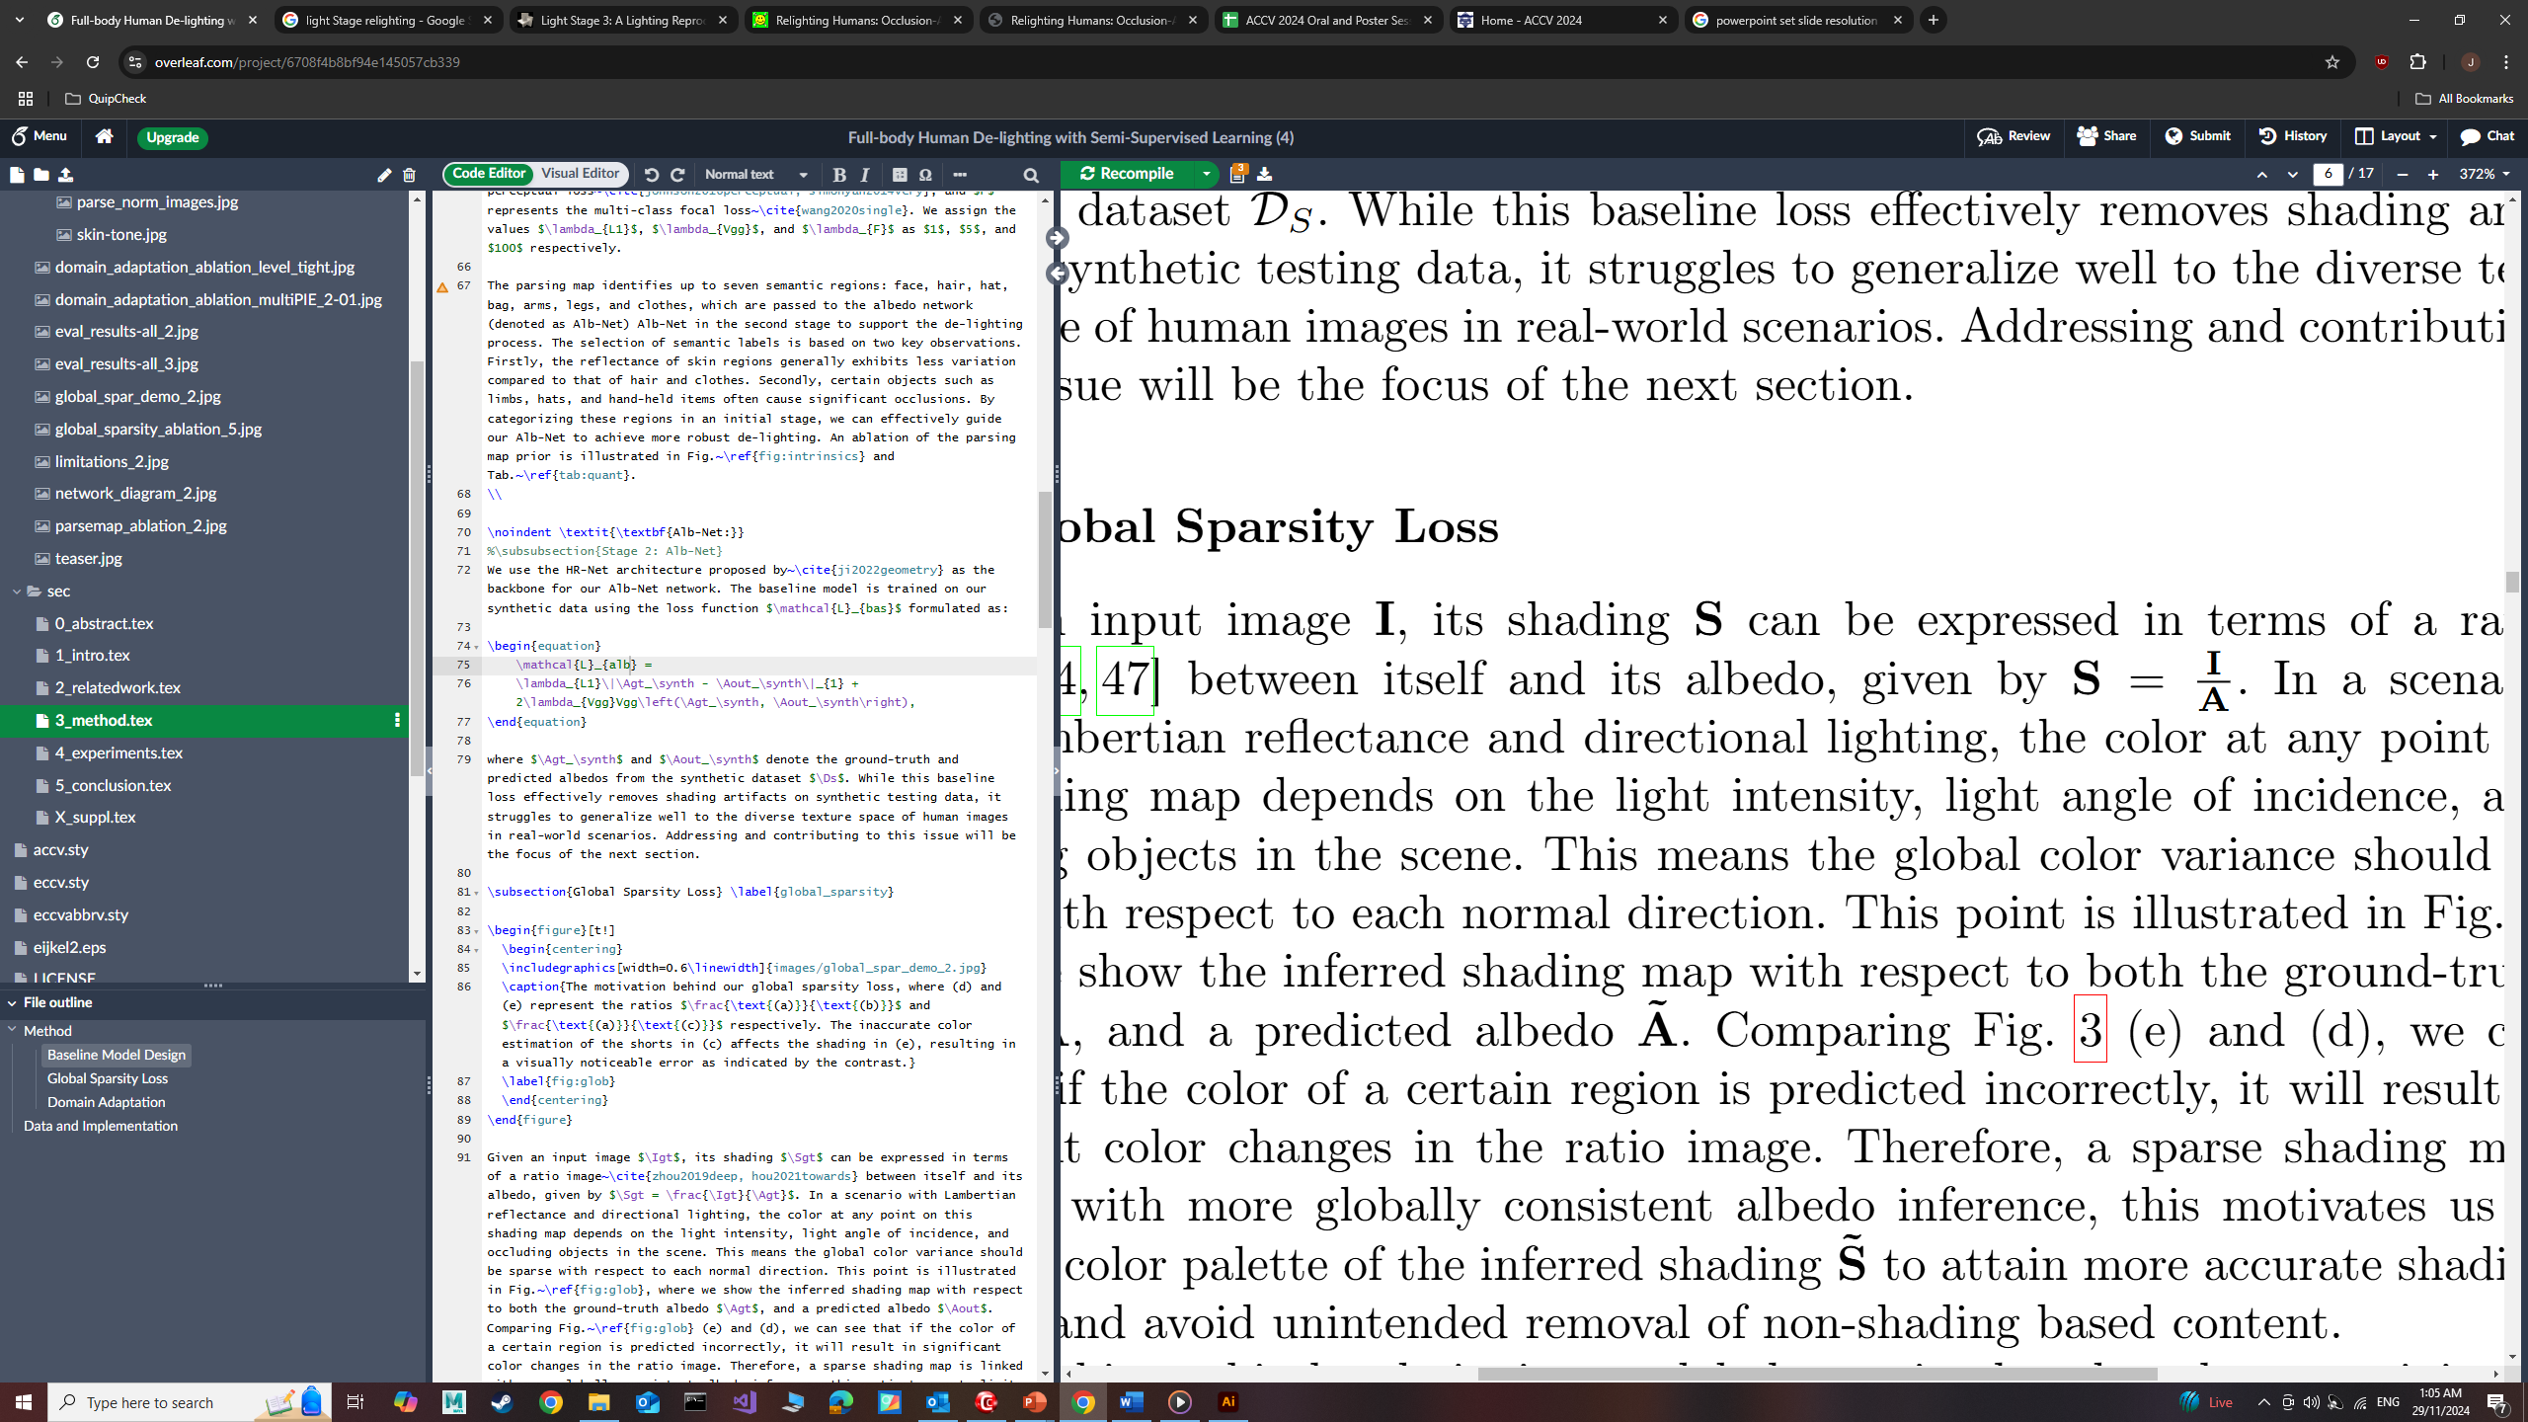
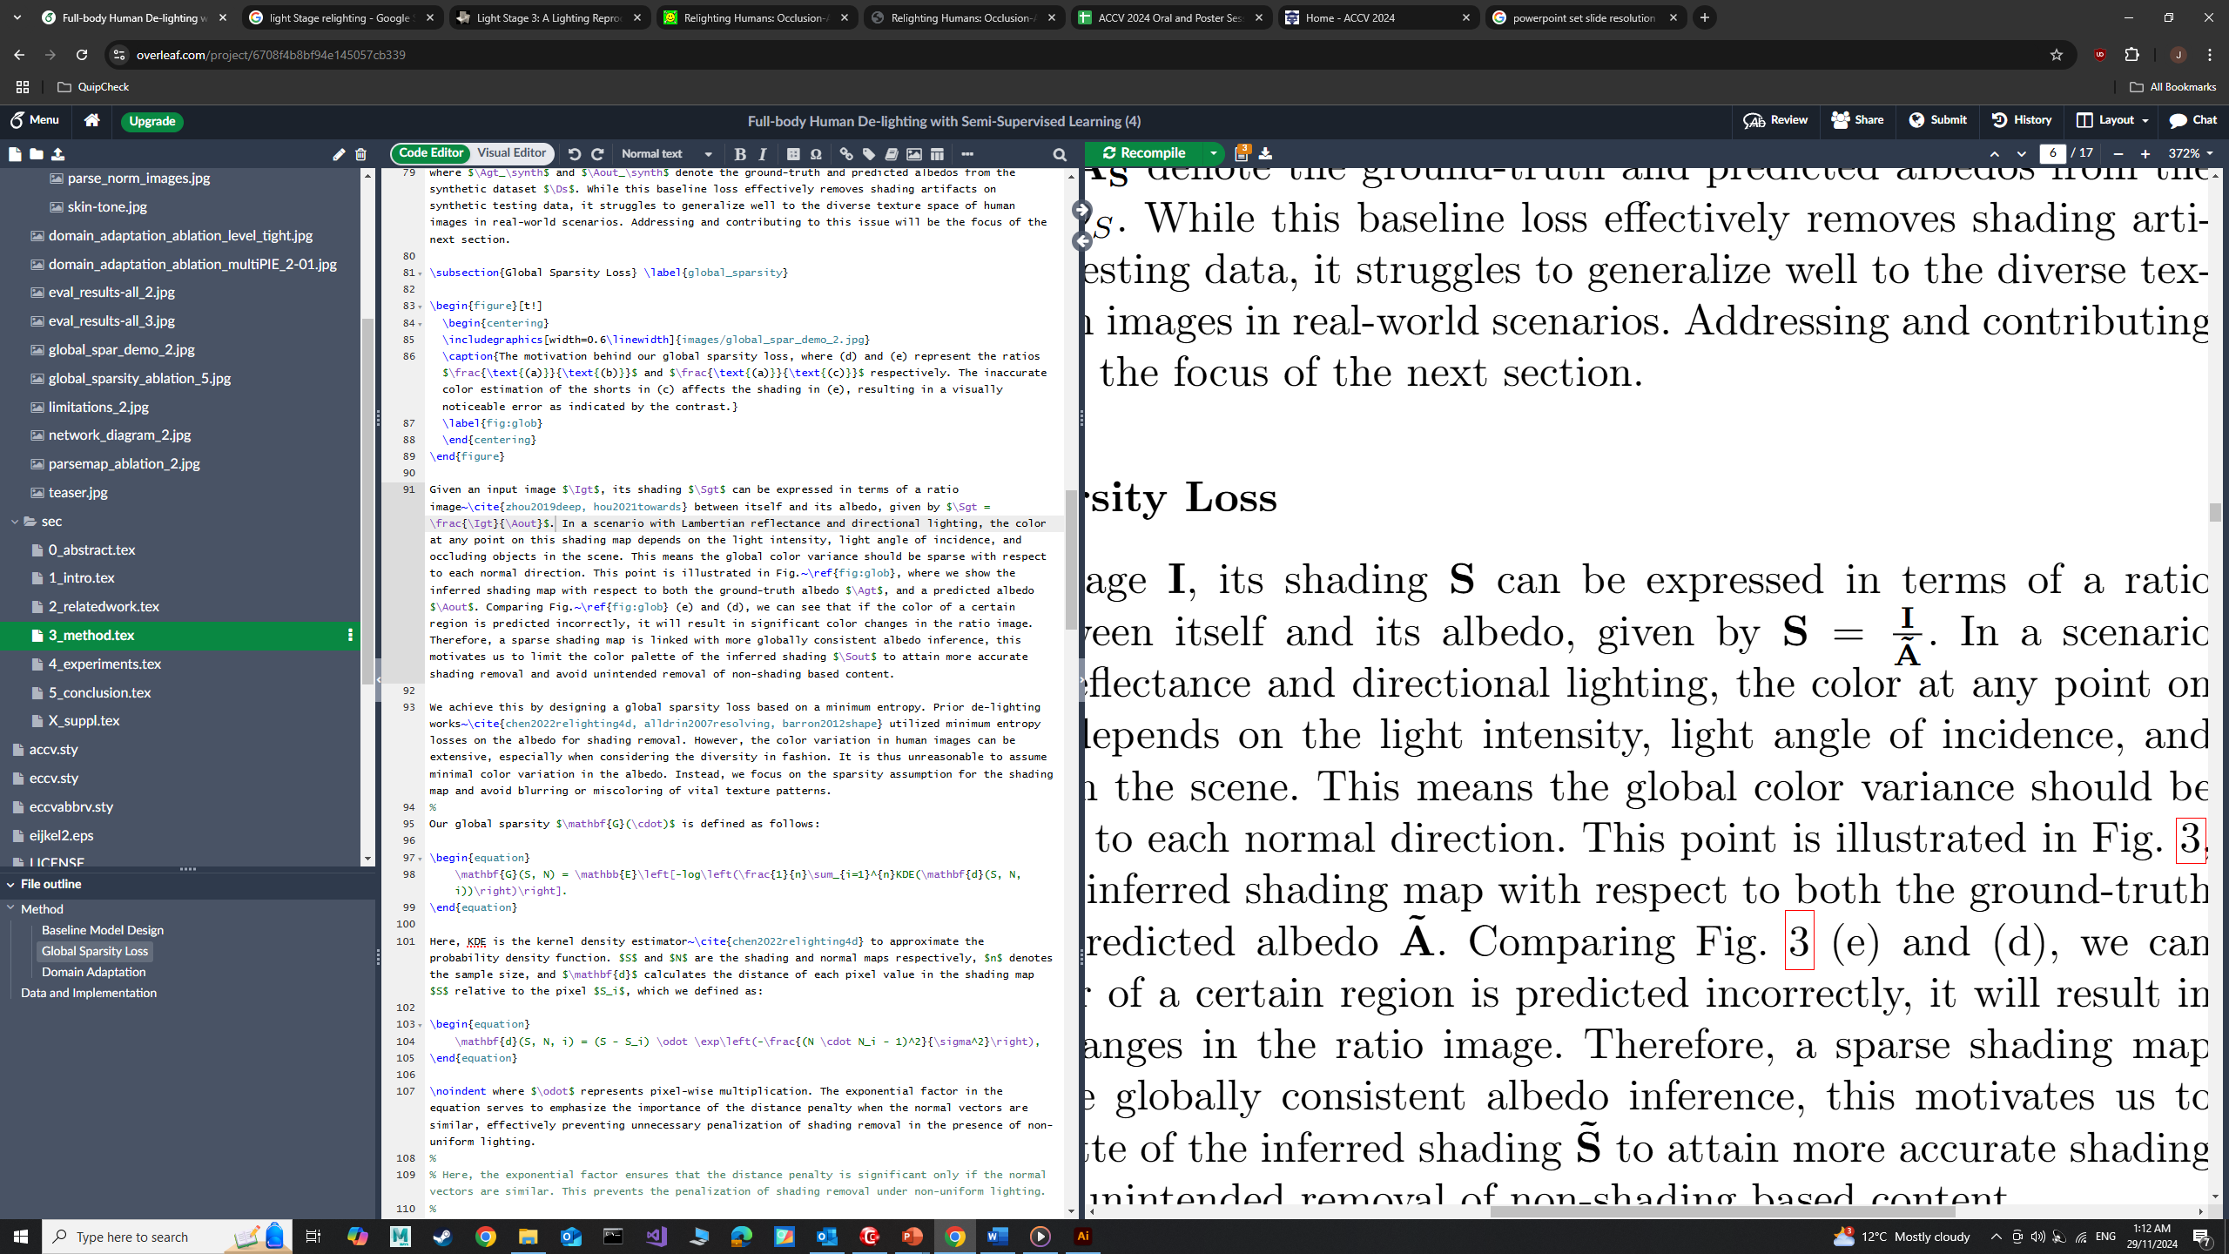
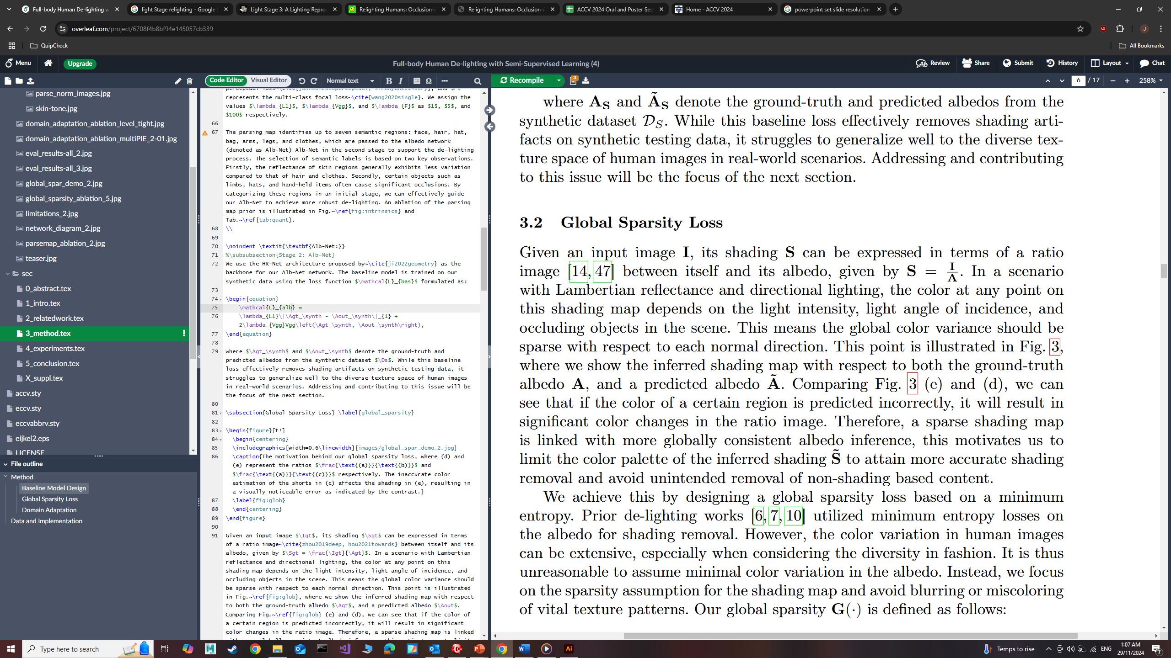
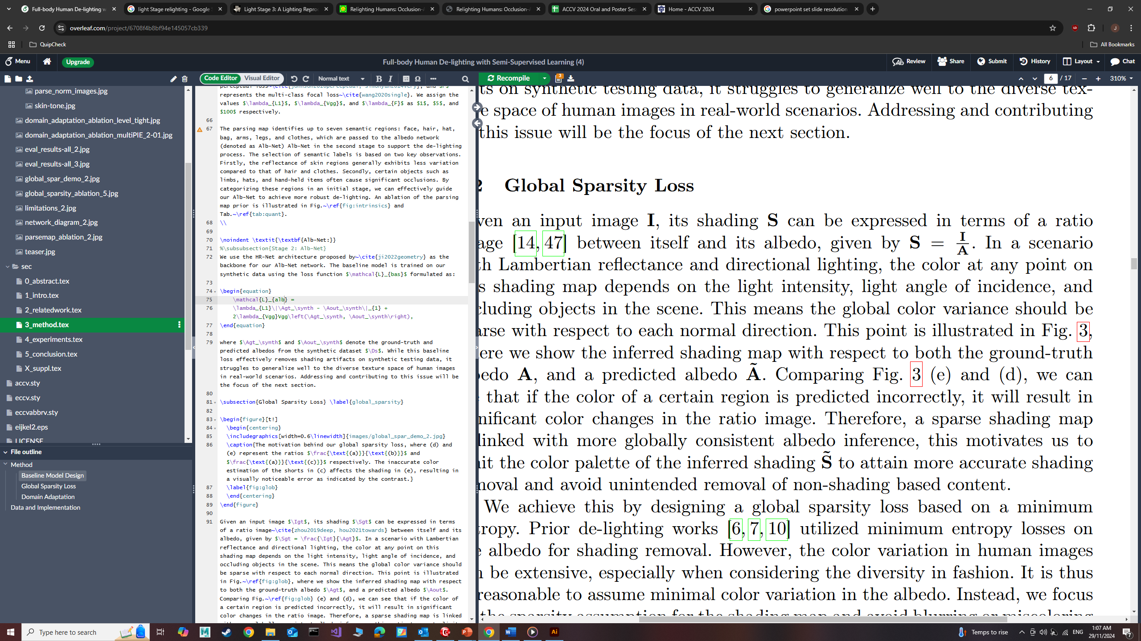
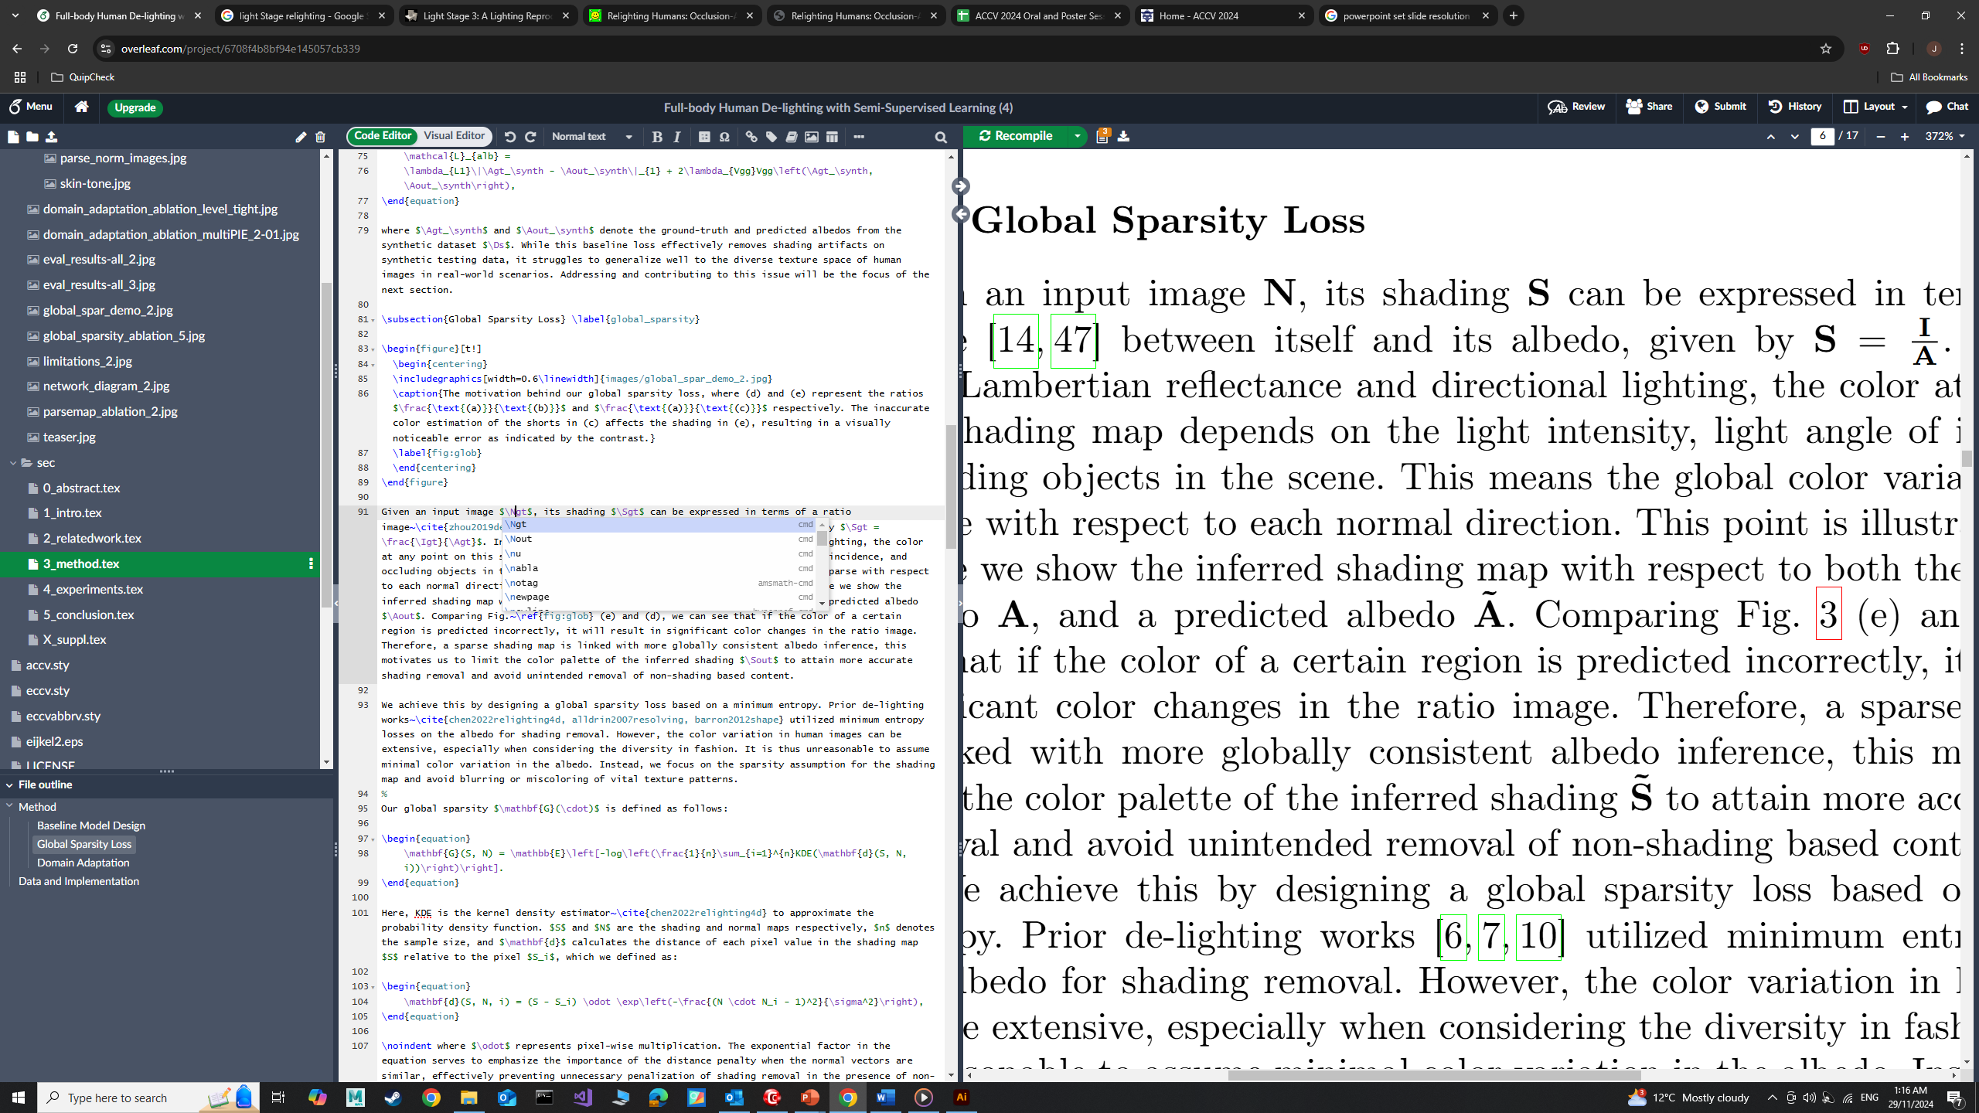
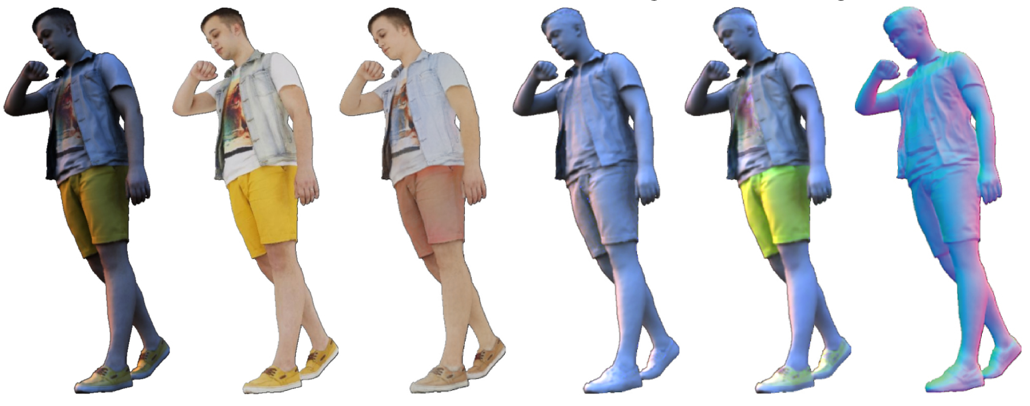
Global Sparsity Loss

Slide 11
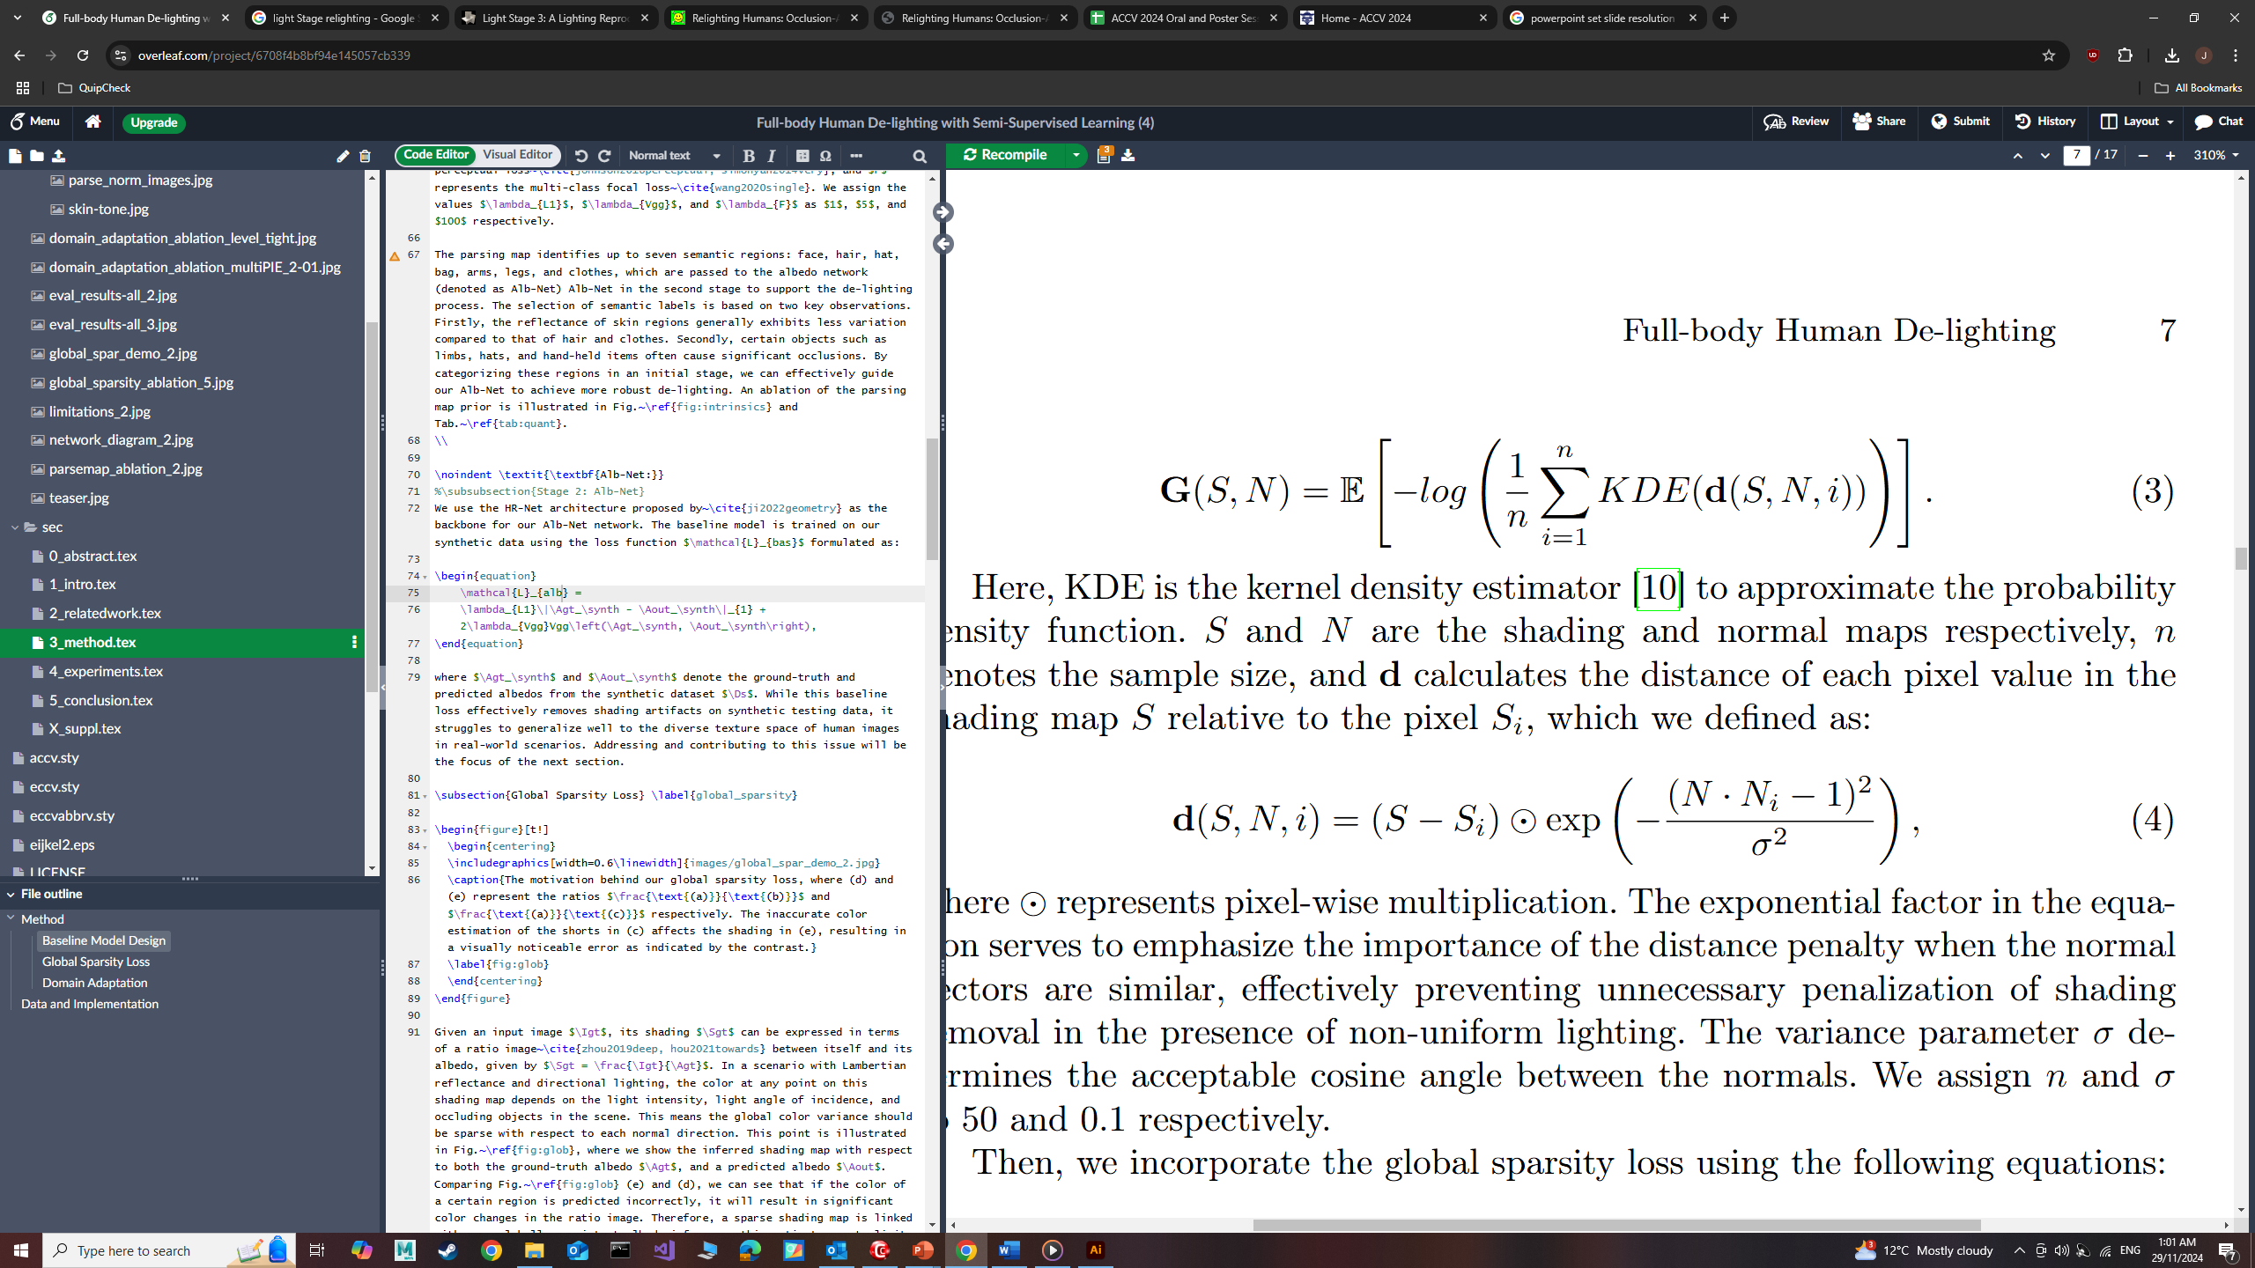
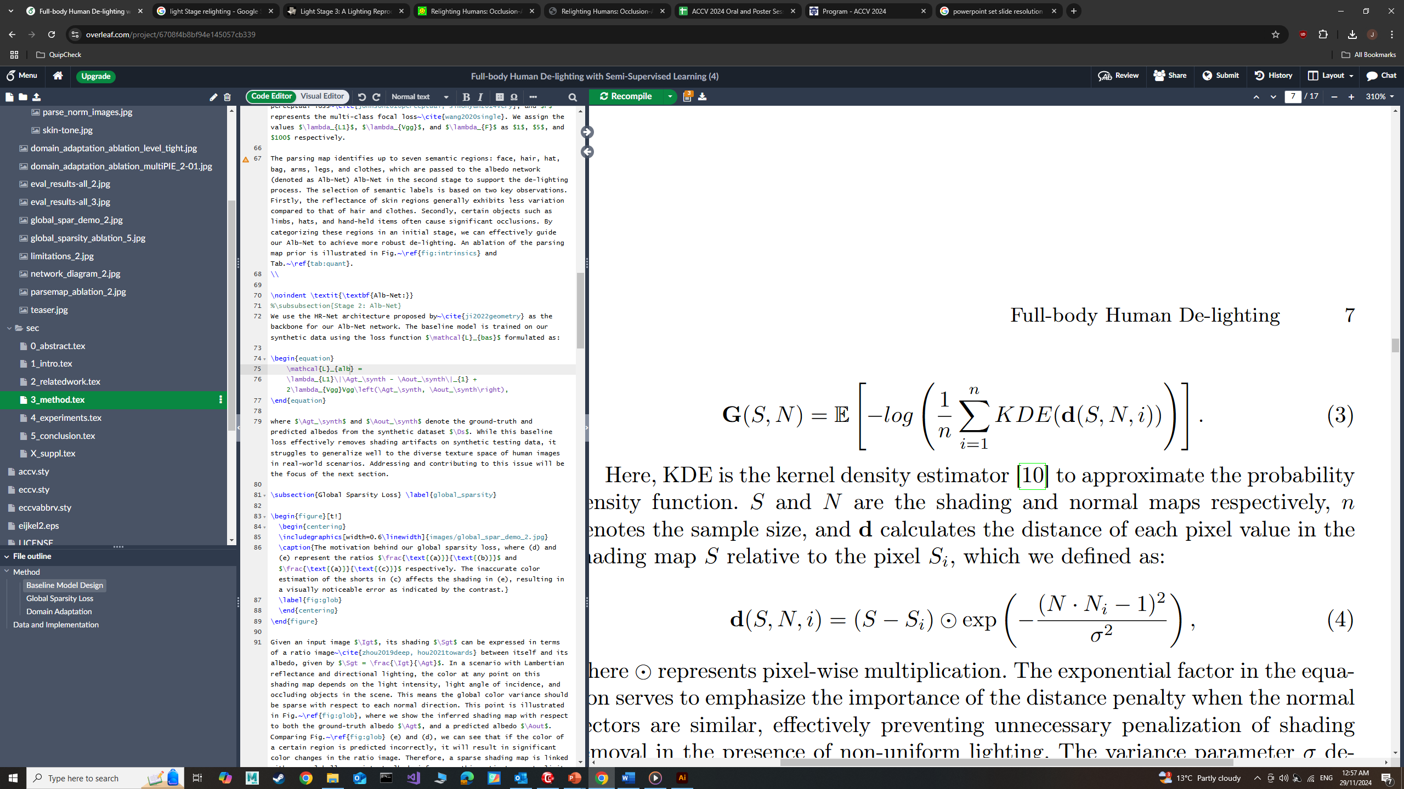
Global Sparsity Loss

Slide 12
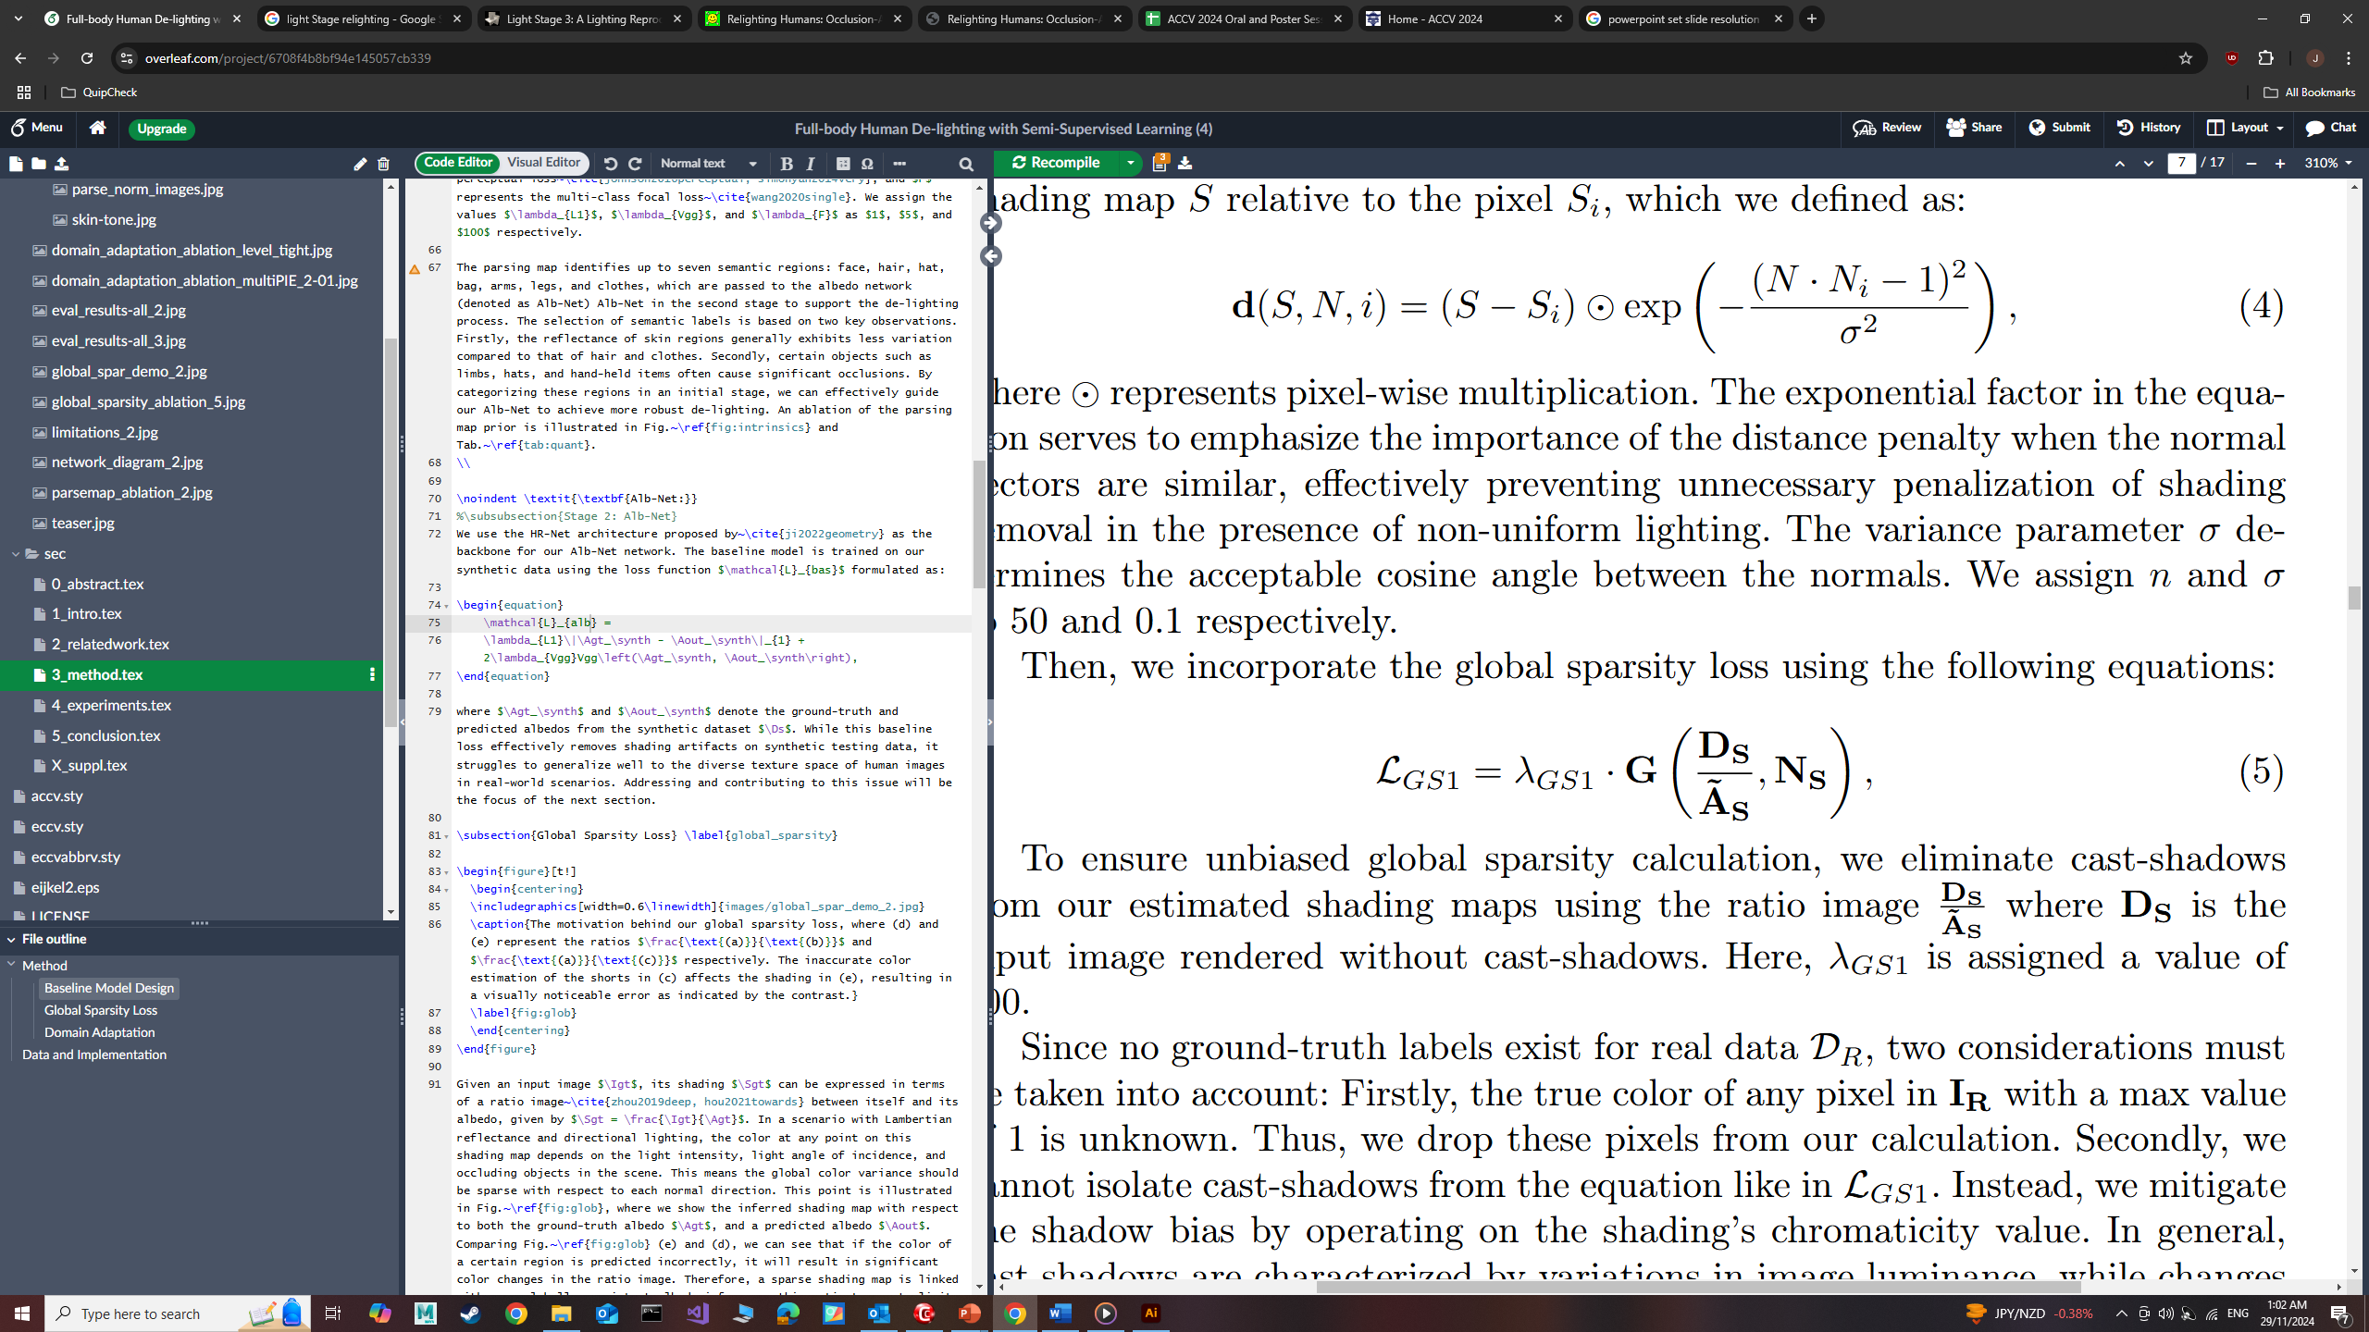
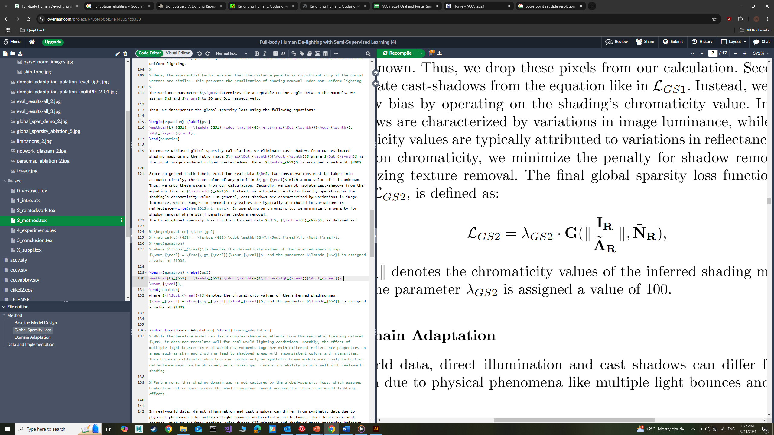
Global Sparsity Loss
Applied to labelled synthetic data
Applied to unlabelled real data

Slide 13
Global Sparsity Loss
Albedo Loss
Global Sparsity Loss
Global Sparsity Loss
Prior Loss
Albedo Loss
Prior Loss
DA Loss
Global Sparsity Loss
Applied to labelled synthetic data
Applied to unlabelled real data

Slide 14
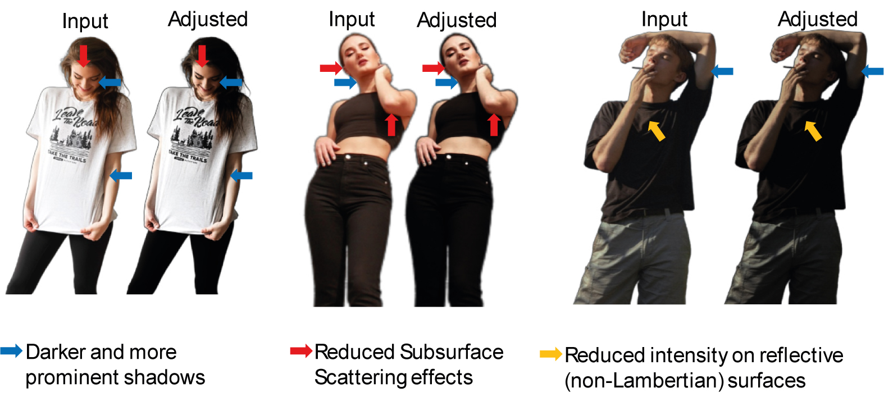
Domain Adaptation
Domain gap exists between real and synthetic data
Apply gamma correction to real-world images
Aligns shading with synthetic renderings
Global operation – preserves non-shading details.

Slide 15
Domain Adaptation
DA Loss

Slide 16

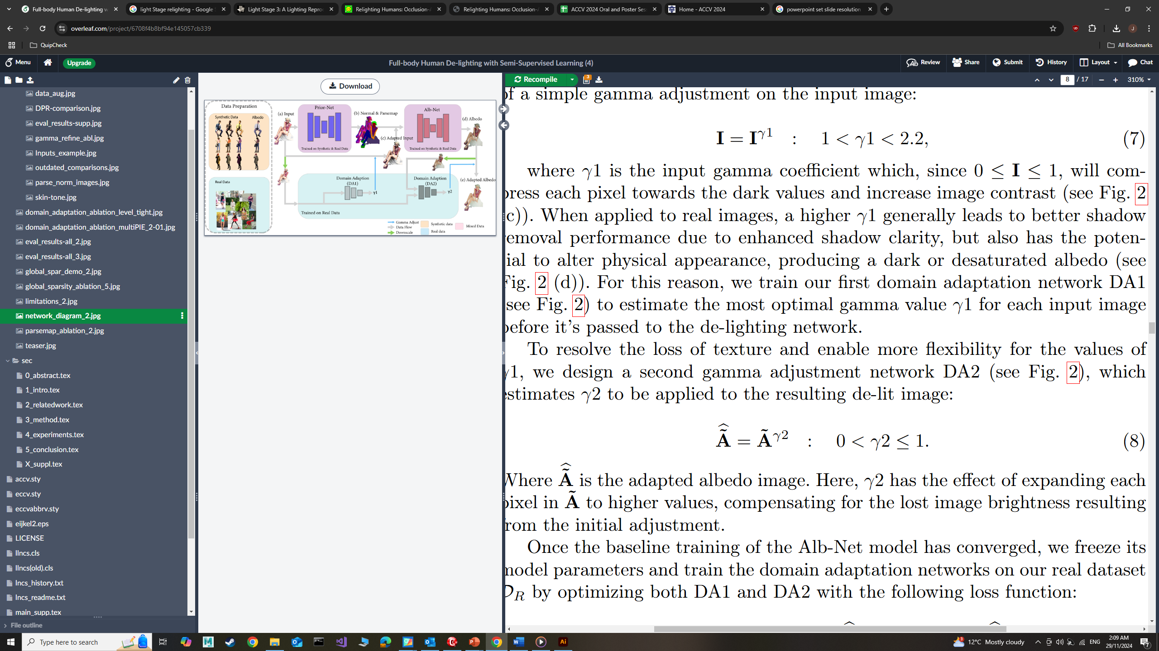
Domain Adaptation
DA Loss

Slide 17
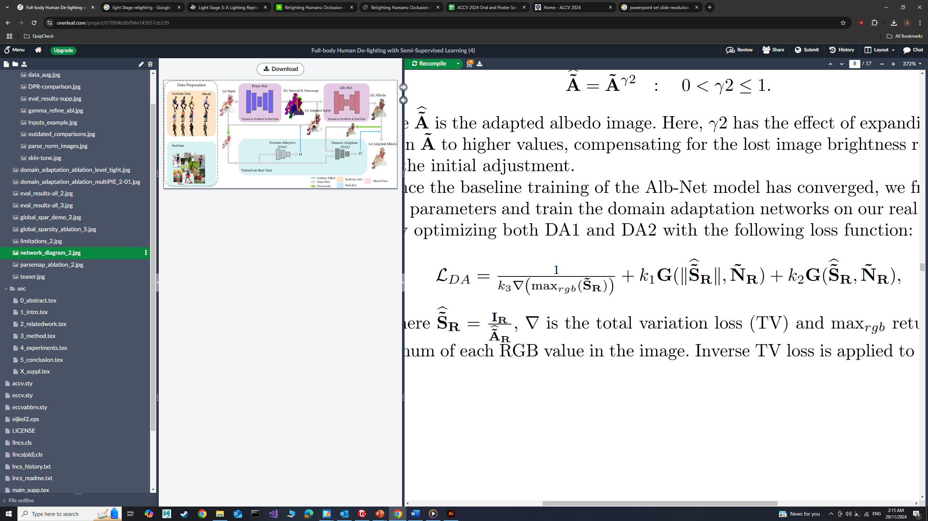
Domain Adaptation
DA Loss
Promote Shadow removal
Regularize texture distortions
DA Loss

Slide 18
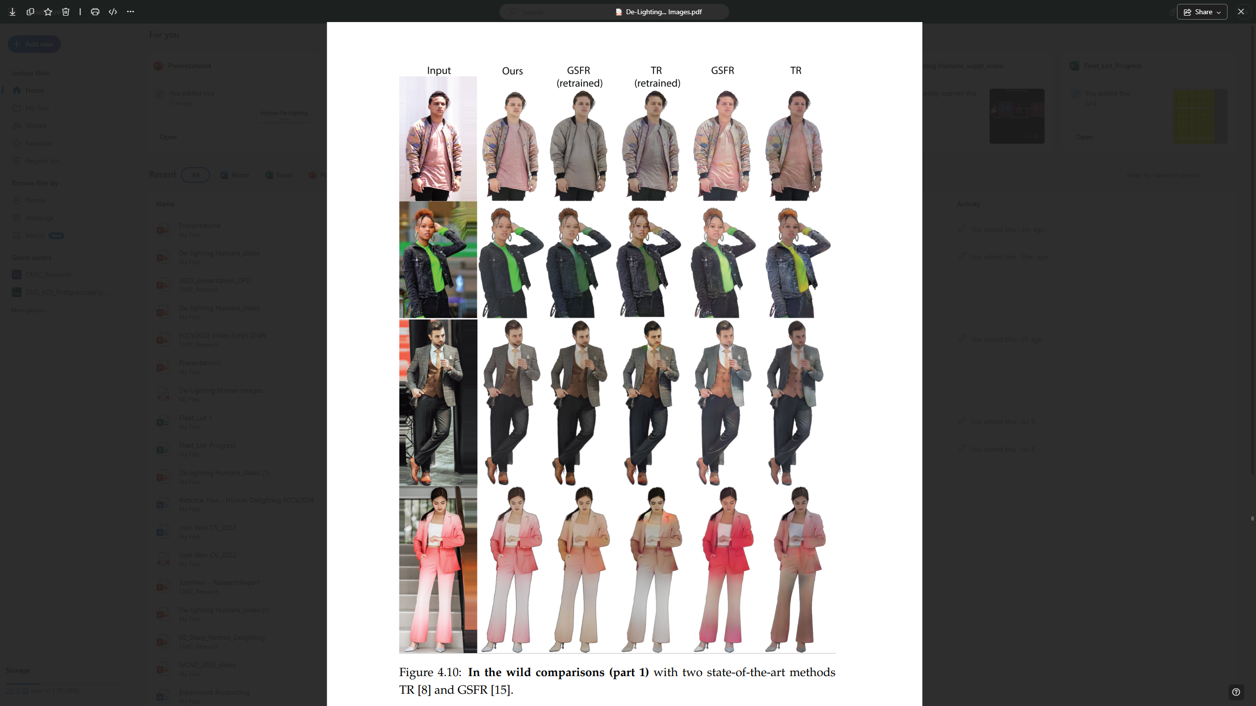
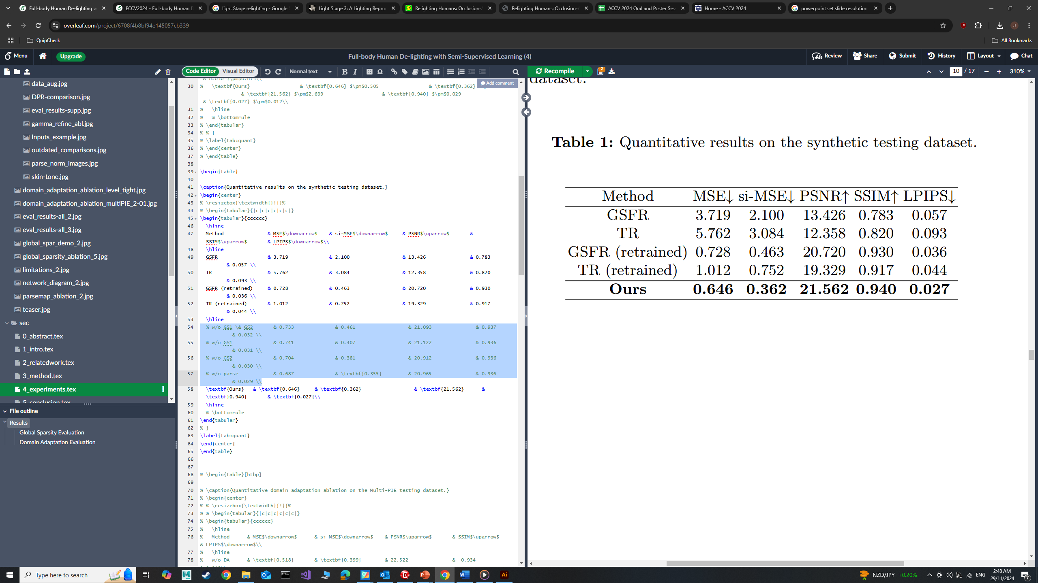
Results - Comparisons
Input
Ours
GSFR (retrained)
TR (retrained)
TR
GSFR
TR: Pandey et al, Total Relighting: Learning to Relight Portraits for Background Replacement”, ACM Trans. Graph., 2021
GSFR: Ji et al, “Geometry Aware Single Image Full-body Human Relighting”, ECCV., 2022

Slide 19
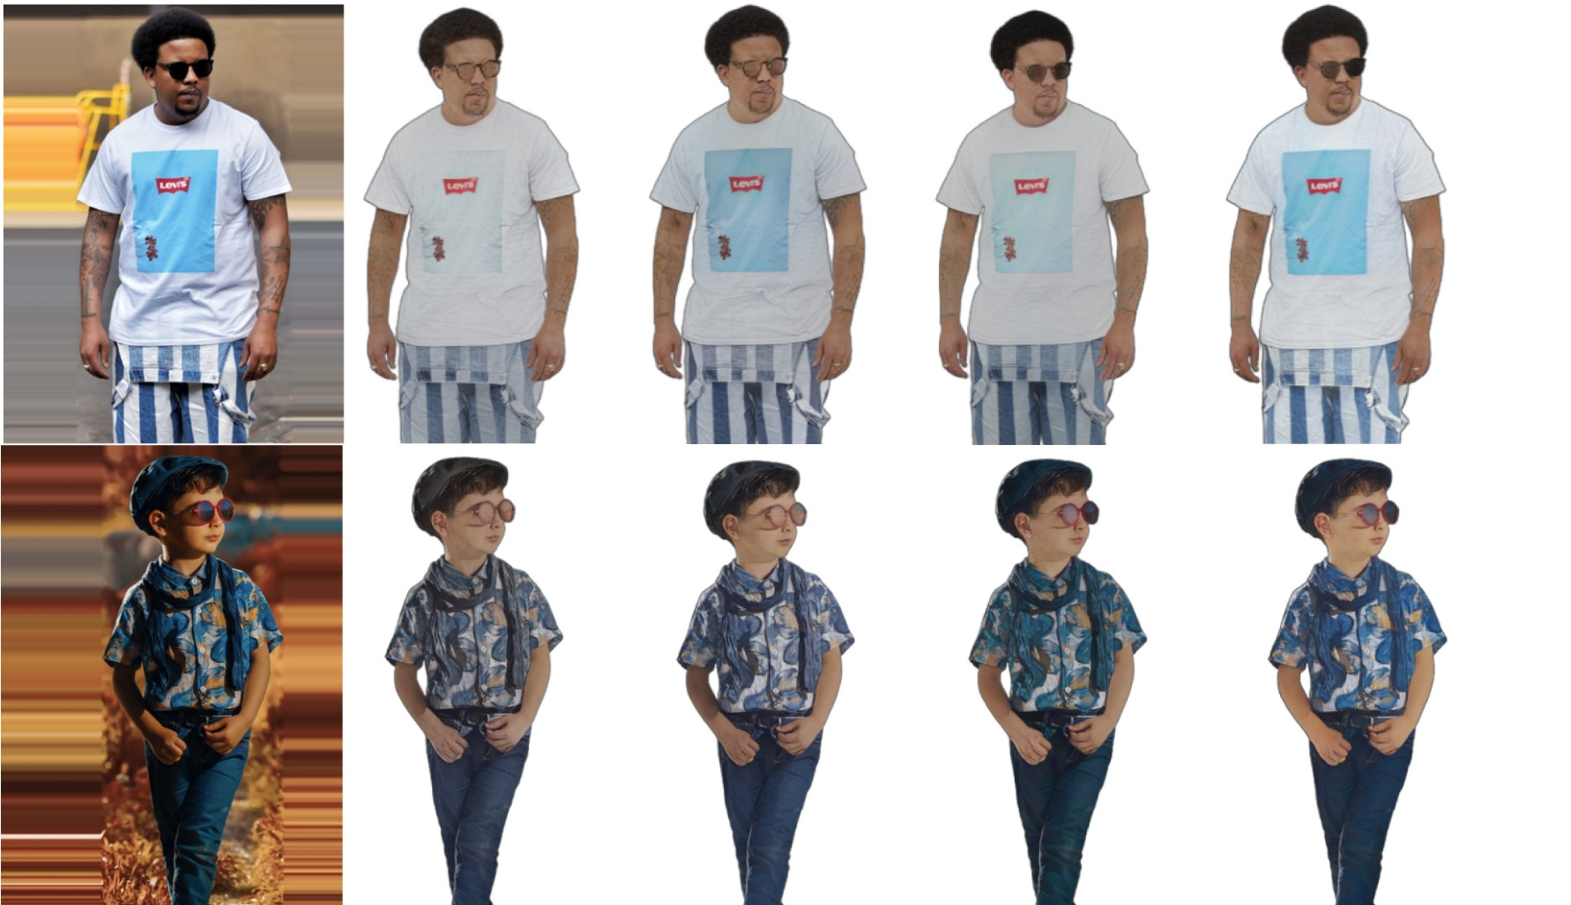
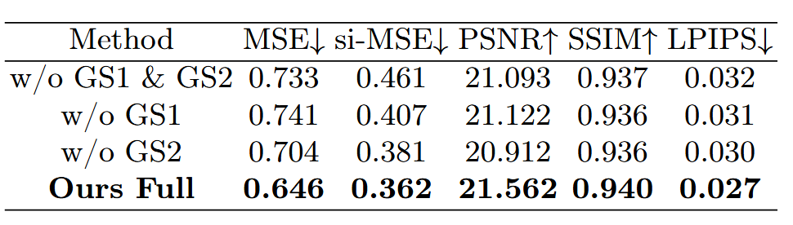
Results – Global Sparsity Ablation
w/o
GS1 & GS2
Input
w/o GS2
w/o GS1
Ours
GS1: Global sparsity for synthetic data
GS2: Global sparsity for real data

Slide 20
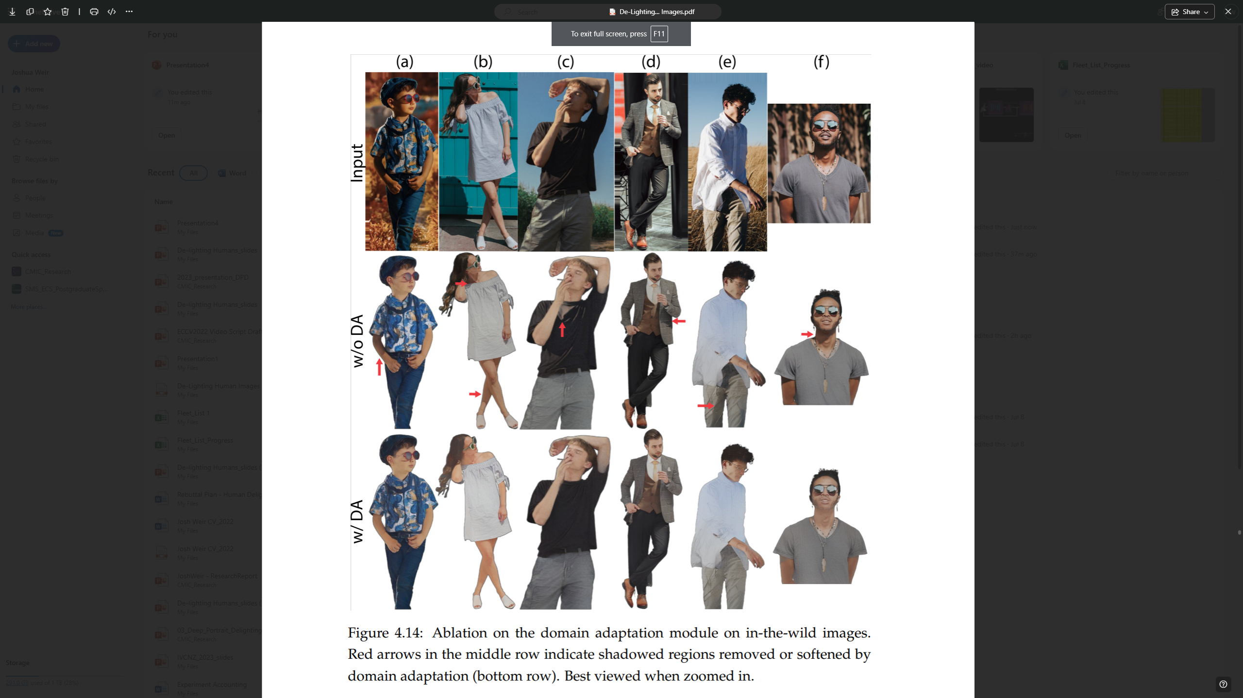
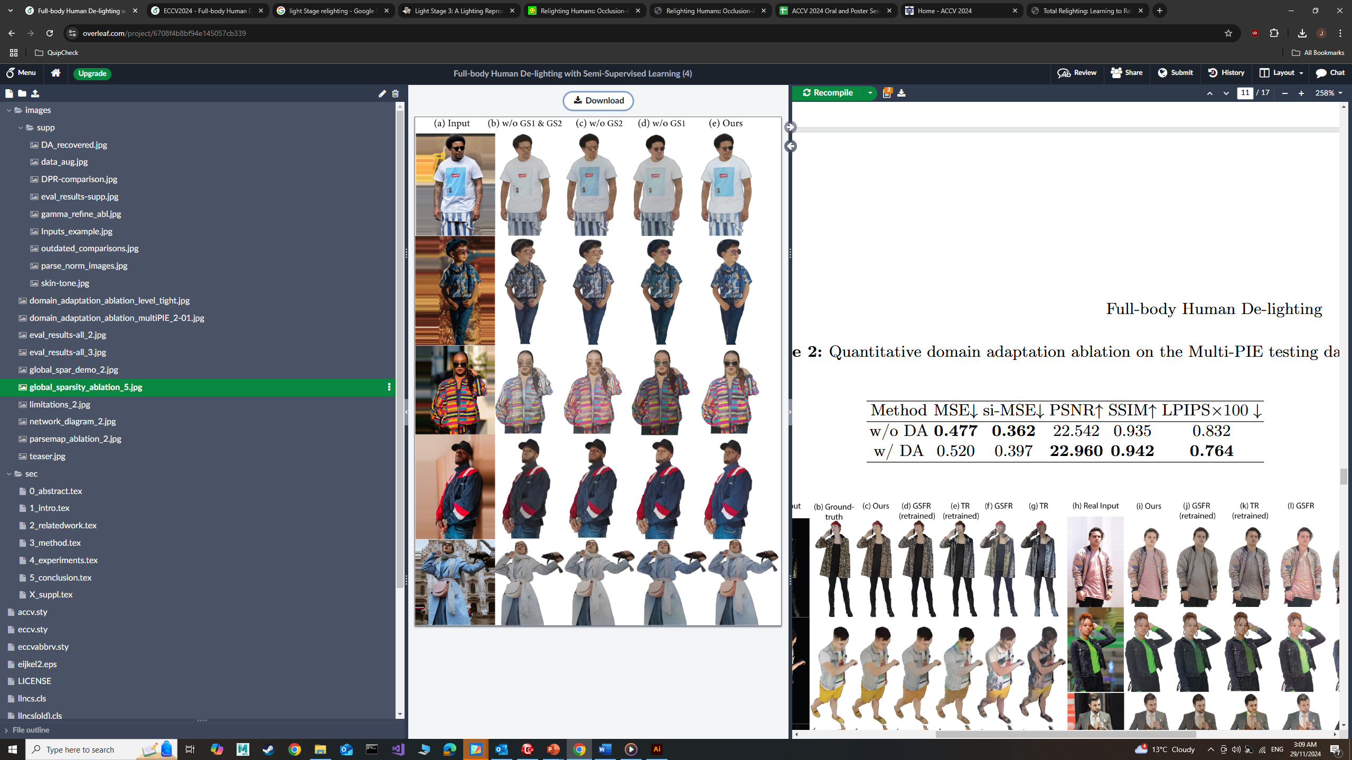
Results – Domain Adaptation Ablation

Slide 21
Conclusion
Contributions
Semi-Supervised Pipeline
Address dataset limitations for full-body de-lighting
Global Sparsity Constraint
Learn diverse textures from real-world images
Domain Adaptation Module
Align real and synthetic data, improve shading removal

Slide 22
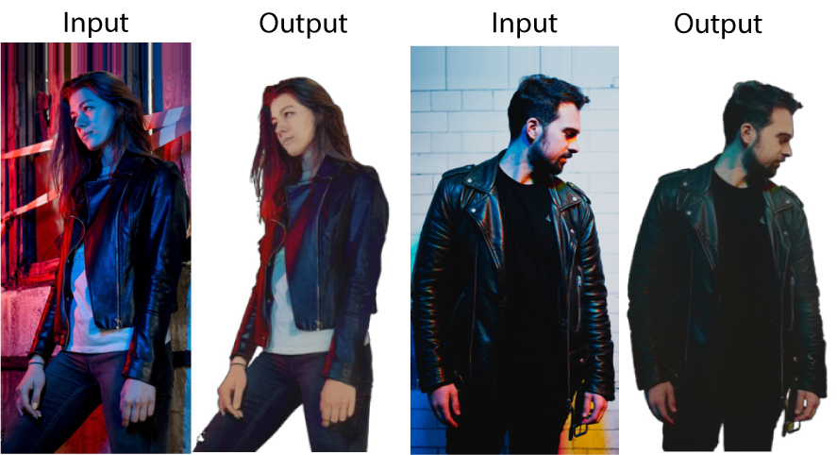
Conclusion
Contributions
Semi-Supervised Pipeline
Address dataset limitations for full-body de-lighting
Global Sparsity Constraint
Learn diverse textures from real-world images
Domain Adaptation Module
Align real and synthetic data, improve shading removal
Limitations
Specular surfaces
Absent in labelled training dataset

Slide 23
THANK YOU!
{josh.weir,andrew.chalmers,j.zhao}@vuw.ac.nz
taehyun.rhee@unimelb.edu.au

